Slide 1
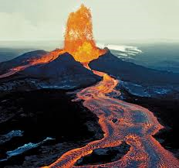
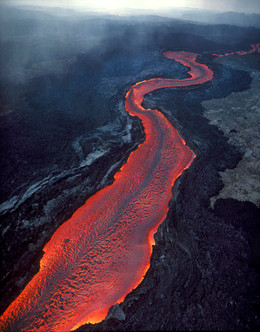
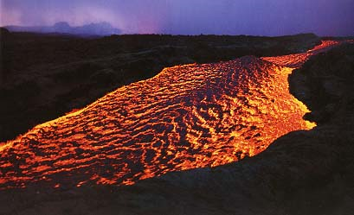
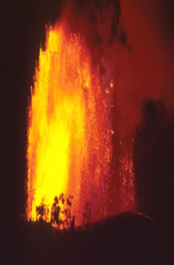
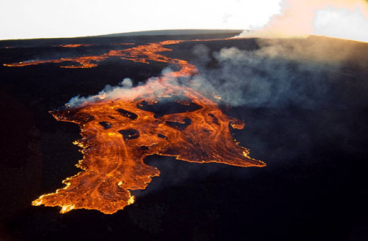
Mauna Loa
Mount Mauna Loa is located on the Hawaiian Islands rising 13,680 feet (4,170 m) above sea level.
Mauna Loa is a shield volcano that is located along the Hawaiian Emperor Chain in the center of the Pacific Ocean.
Mauna Loa
Mauna Loa is a shield volcano, therefore it is a gently sloping mountain that is produced from a large number of very fluid lava flows with a low viscosity. The volcano has been erupting for about 100,000 years from the volcanoes primary volcanic center. There is a crater at the mountain's summit where most of the mountains lava is released. It has produced both Aa and Pahoehoe flows, with very little amounts of pyroclastic flows. Mauna Loa shares the rare Hawaiian hotspot with its neighboring islands. This landform has been constructed over a unique volcanic hotspot which is a place on earths crust where there is a weak spot where magma can escape. The volcano is constructive as it builds up land with the magma released.
The volcano is constructed by the all common rock type called basalt. This means that the rock is igneous and formed from cooling magma. This rock formed as magma escapes from the central crater and cools in lava flows on earth.
Mount Mauna Loa has had a history of 33 eruptions since 1843 so there will be many to come. Scientists in the Volcanic Observatory on Kilauea are keeping a close eye on the evident future volcanic lava flows and eruptions. The volcano also has a history of volcanic earthquakes, so there will be some to come.

Slide 2
Citations
"Mauna Loa Earth's Largest Volcano." USGS. Hawaiian Volcanic Observatory, n.d. Web. 20 Nov. 2013. <http://hvo.wr.usgs.gov/maunaloa/>.
"Mauna Loa Volcano." Hawaiian Center for Volcanology. N.p., n.d. Web. 20 Nov. 2013. <http://www.soest.hawaii.edu/GG/HCV/maunaloa.html>.

