Slide 1
Chemistry
DI Biology
Jennifer Naples

Slide 2
Elements
An element is a substance that can not be broken down into smaller substances
There are 90 naturally occurring elements in nature
All elements are listed in the periodic table

Slide 3
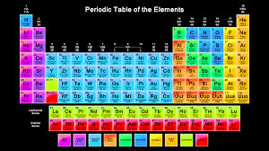
Periodic Table of Elements
The periodic table of elements

Slide 4
Elements
There are 25 elements needed for all living things
96% of the mass of human beings is:
Carbon
Hydrogen
Oxygen
Nitrogen

Slide 5
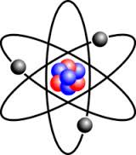
Atoms
An atom is the smallest part of an element
There are 4 parts in the arrangement of an atom
Nucleus - the center of an atom
Proton - (+)charged particle found inside of the nucleus
Electron-(-)charged particle found outside the nucleus
Neutron – Particle found inside the nucleus with NO charge

Slide 6
How Elements Combine
Compound – a substance that is made from two or more different elements bound together
Example: Salt(NaCl) or water (H2O)
Molecule – a group of atoms held together by covalent bonds
Example: oxygen (O2)

Slide 7
Compounds and Bonding
Compound – a substance composed of elements that are chemically combined
What does it mean to be chemically combined
Chemical vs. Physical change

Slide 8
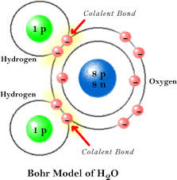
Covalent Bonds
When two atoms share electrons
Example: water
Strong bonds
Most living things are made
Up of covalent bonds

Slide 9
Ionic Bonds
When two elements of opposite charge combine.
An ion is an atom that has acquired a positive or negative charge
Example: Na+Cl = NaCl
Weak bonds

Slide 10
Chemical Reactions
When they occur:
Bonds are formed
Bonds are broken
Substances are changed or altered into different substances

Slide 11
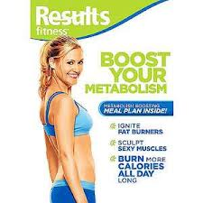
Metaboliosm
Refers to the chemical reactions that take place within an organism

Slide 12
Chemical Equations
Reactants – substances that undergo the reaction
Products – substances which are formed from a reaction
Subscripts – The number of atoms of each element in a molecule
Coefficient – The number before each chemical formula(number of molecules of that substance)

Slide 13
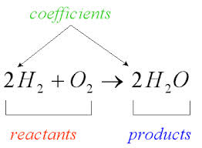
Examples of Chemical Equations
Water

Slide 14
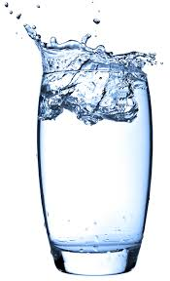
Water
Water is a VERY important molecule.
It provides a place for chemical reactions
It is the universal solvent
Provides a means of transport
Makes up a large portion of living organisms
Water has a + end and a – end – like a magnet
Happy Hydrogen!!

Slide 15
Water is Polar
The Oxygen atom w/8 protons attracts the shared electrons more strongly that the H atom with 1 electron. This makes the H end + and the O end -.
Water molecules attract each other, ions and other polar molecules.
This gives water the ability to dissolve many substances.

Slide 16
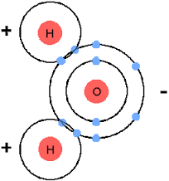
Polar Water Molecule

Slide 17
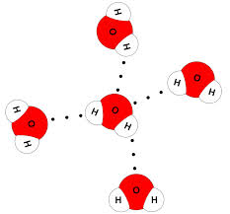
Water
Hydrogen Bond-a weak bond that forms when water molecules attract other water molecules.

Slide 18
Cohesion
An attraction between molecules of the same substance.
Because of hydrogen bonds water molecules are attracted to each other.
Ex.-water molecules on the surface of a body of water have a strong attraction called “surface tension”

Slide 19
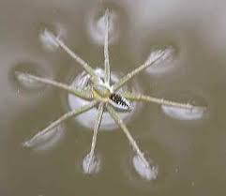
Cohesion

Slide 20
Adhesion
An attraction between molecules of different substances.
Occurs between water and other molecules like glass.
Occurs when water is drawn up into small tubes(like from the roots to the stems of plants)
Called Capillary Action

Slide 21
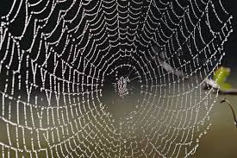
Adhesion

Slide 22
pH
pH – refers to the hydrogen ion (H+) versus hydroxide ion (OH-) concentration in a solution
Acid – a substance that has more H+ ions and has a pH BELOW 7
Base – a substance that has more OH- ions and has a pH ABOVE 7

Slide 23
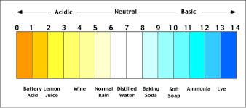
pH Scale

Slide 24
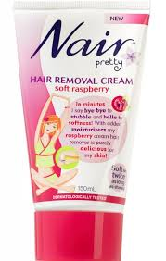
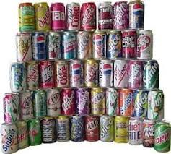
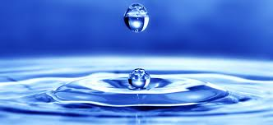
pH Examples
Pure water has a pH of 7.0 which means it has a equal amount of H+ and OH- ions
Hair remover(Nair) has a pH of 13.0
Soda has a pH of 3.0

Slide 25
pH
Acids TASTE sour
Lemon juice
vinegar
Bases FEEL slippery
Soap
bleach

