Slide 1
Enzymes
Jennifer Naples
Biology

Slide 2
What is an Enzyme?
An enzyme is a biological catalyst
What is a catalyst?
Something that makes a chemical reaction happen faster at a lower temperature
A trigger
What sets you off?

Slide 3
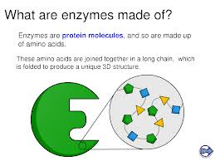
What is an Enzyme?
Enzymes break down substances in the body
Enzymes make other substances

Slide 4
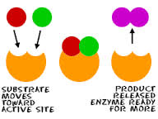
How do Enzymes Work?
Enzymes have a “keyhole” spot where they join with a substrate
Substrate – molecule being broken down
Enzyme + Substrate =Reaction

Slide 5
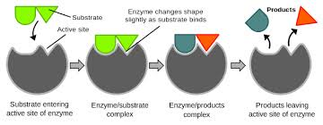
How Do Enzymes Work?
A substrate will find the “active site” of an enzyme
They fit together like a lock and key
Reaction occurs
Enzyme is released and ready to use again

Slide 6
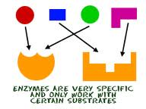
What do Enzymes Need in Order to Work?
Enzymes
Substrate
Enzyme and substrate MUST fit together
Right temperature
Right pH

Slide 7
What Happens After the Reaction Occurs?
A product is formed and released
A molecule is broken down
Enzyme may be reused
An enzyme that no longer works is called “denatured”

Slide 8
Check for Understanding
What is an enzyme?
A biological catalyst
What is a substrate?
What do enzymes need in order to work?
Correct temperature, pH enzymes and substrate
What happens when the process is finished?
Enzymes may be reused

