Slide 1
Nuclear Energy
Environmental Science
Mrs. Naples

Slide 2
What is Nuclear Energy?
Energy that exists within the nucleus of an atom.
Atoms are split and the energy is released
Nuclear FISSION is the breaking apart of an atom

Slide 3
How does Fission Work?
An atom of Uranium 235 is split
Neutrons are released
The new neutrons cause other atoms to split
This is called a chain reaction

Slide 4
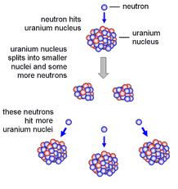
Nuclear Fission
Uranium 235 fission

Slide 5
Nuclear Power Plants
Nuclear reactions in a power plant are controlled.
Energy is released slowly
Tremendous heat is generated
Heat is used to boil water and create steam
Steam drives turbine which drives a generator

Slide 6
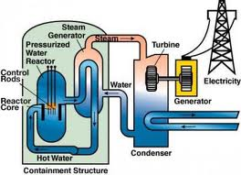
Nuclear Power Plants
Inside a nuclear power plant

Slide 7
What if it is Not Controlled?
If nuclear energy is not controlled the release of energy escalates out of control.
An atomic bomb is an example of nuclear energy out of control.
The chain of energy will continue until all fissionable material is used up.

Slide 8
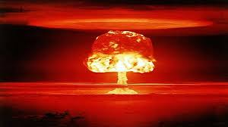
Atomic Bomb Explosion
Mushroom Cloud from Atomic Bomb

Slide 9
Advantages of Nuclear Energy
Rich energy source
1 gram of Uranium 235 delivers about as much energy as 3.5 metric tons of coal
Nuclear energy does not create gasses such as carbon dioxide

Slide 10
Why Don’t We Use Nuclear Energy More?
Produces radioactive waste
No facility to dispose of nuclear waste
Short supply of Uranium 235
Expensive to build and run plants
Safety concerns – nuclear meltdown
Reaction can get out of control and heat can destroy the buildings and spew radioactive products into the air

Slide 11
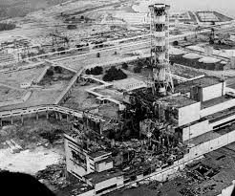
Nuclear Meltdown
Chornobyl – Soviet Union 1986

Slide 12
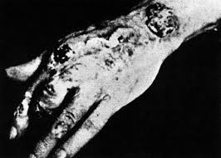
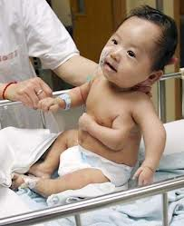
Radiation
Nuclear waste contains high levels of radiation
Radiation can have various negative effects on the human body and can even cause death

Slide 13
Fission VS. Fusion
Fission is the breaking apart of an atom
Fusion is the combining of atoms
Fusion powers our stars, including the sun
It is possible to create energy using fusion BUT it has proven to be very difficult at this time
Must be heated to extremely high temperatures
Need very high concentrations
Possibility for great amounts of energy.

Slide 14
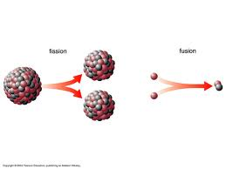
Fission VS. Fusion
Fission and fusion are opposite reactions

Slide 15
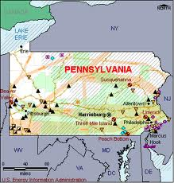
Nuclear Energy in PA
Power plants in PA

Slide 16
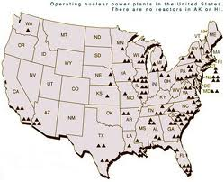
Power Plants in the U.S.
Most power plants in the United States are on the eastern side of the country

