Slide 1
Photosynthesis
Biology
Mrs. Naples

Slide 2
Energy
All living things need energy to thrive and survive
We could not survive without energy
Why do we need energy?
Write down 2 examples of things we need energy for.
_________________________
_________________________

Slide 3
Autotrophs and Heterotrophs
Autotrophs – organisms that make their own food
Plants
Heterotrophs – organisms that obtain energy from the foods they consume
Humans
Catipillers
Can you think of another example?
_________________________________

Slide 4
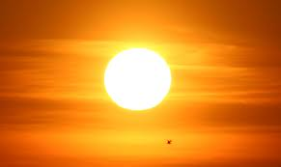
The Sun
Ultimately almost all living things get their energy from the sun.
In order to live all living things MUST release energy in sugars and other compounds.

Slide 5
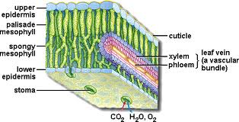
Anatomy of a Leaf
Cross section of a leaf

Slide 6
Anatomy of a Leaf
Xylem – system of tubes and transport cells that circulate water and dissolved minerals throughout the plant
Phloem – system of tubes that transport sugars and other molecules created by the plant.(dripping sap usually comes from the phloem)
Stoma – a pore found in the epidermis of leaves used in the exchange of gas. Stomata release oxygen and take in carbon dioxide. They are usually open during the day and closed at night.

Slide 7
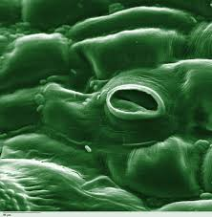
Stoma
Stoma(also called stomata)

Slide 8
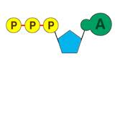
Chemical Energy
Living things use chemical fuels
One of the principal chemical fuels is ATP
ATP = adenosine triphosphate
ATP is made up of adenine, sugar(ribose) and phosphate groups.

Slide 9
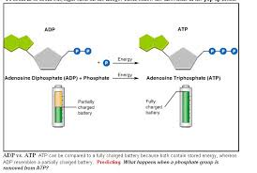
Chemical Energy
ADP – almost the same as ATP but only has 2 phosphates

Slide 10
Check for Understanding
What is an autotroph?
What is a heterotroph?
What is ATP?
What is ADP?
How are they alike?
How are they different?

Slide 11
What is Photosynthesis?
Key process identified in energy production
Plants use the energy of sunlight to convert water and carbon dioxide into high energy carbohydrates (sugar and starch) and oxygen.
Photo – light
Synthesis – putting together
Using light to put something together
Chemo - chemical
What do you think chemosynthesis means?

Slide 12
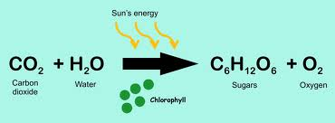
The Photosynthesis Equation
Photosynthesis uses the energy of sunlight to convert water and carbon dioxide into high energy sugars and oxygen.

Slide 13
Capturing the Energy
How do plants capture the suns light?
Plants gather the sun’s energy with light absorbing PIGMENTS.
The plants main pigment is chlorophyll.
There are two types of chlorophyll.
Chlorophyll A
Chlorophyll B

Slide 14
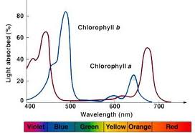
Capturing the Energy
Chlorophyll A – absorbs light in blue violet and red
Chlorophyll B absorbs light in blue and red

Slide 15
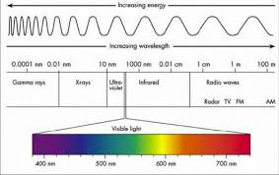
The Color Spectrum
Chart of the color spectrum

Slide 16
The Color Spectrum
All colors are always present but can not always be seen
When we see red it is because red is being reflected – all other colors are being absorbed.
When we see blue it is because blue is being reflected and all other colors are being absorbed.
What color are you reflecting? Absorbing?

Slide 17
Energy from Sunlight
When chloroplasts absorb light from the sun, they are also absorb energy from the sun.
Much of this energy is transferred to electrons in the chlorophyll molecule which raises the energy level.
This energy in the electrons is what makes photosynthesis work.

Slide 18
Chloroplasts
A chloroplast contains sac-like membranes called thylakoids.
Thylakoids are arranged in stacks called grana.
Photosystems are clusters of pigment and protein that absorb light energy.
Stroma – region outside the thylakoid membranes.

Slide 19
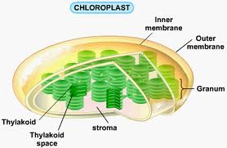
Inside a Chloroplast
The structures within a chloroplast

Slide 20
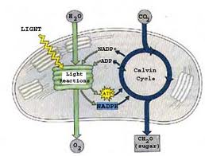
An Overview of Photosynthesis

Slide 21
An Overview of Photosynthesis
There are two stages of photosynthesis.
The Calvin cycle which does not require light.
The light dependent reactions which require light.

Slide 22
Light Dependent Reactions
Light dependent reactions use energy from sunlight to produce ATP, NADPH and Oxygen
Takes place within the thylakoid membrane of chloroplasts

Slide 23
Calvin Cycle
Takes carbon dioxide, ATP and NADPH and creates sugar
Takes place in the stroma.
Does not require sunlight.

