Slide 1
Energy
Mrs. Naples
Environmental Science

Slide 2
Nonrenewable Resources
What is a nonrenewable resource?
A material or energy source that ___________ be replaced during a ____________________.
Most nonrenewable resources took millions of years to form.

Slide 3
Nonrenewable Resources
Ores
Rocks
Fossil Fuels
Coal
Petroleum and Natural Gas

Slide 4
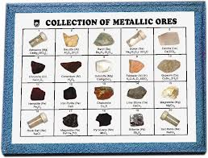
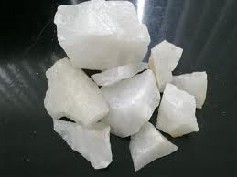
Nonrenewable Resources
Ores – deposits of minerals from which valuable metals and nonmetals can be obtained for profit
metallic
nonmetallic

Slide 5
Nonrenewable Resources
Metallic Ores – iron, aluminum, copper, zinc, lead, silver, gold and manganese(among others)
Formed by chemical reactions from hot solutions percolating through cracks in the Earth’s rocks.

Slide 6
Nonrenewable Resources
Nonmetallic Ores – fluorite, sand, gravel, diamonds, gypsum, sulfur, talc and quartz
Many are used for building materials such as cements.
Used as fertilizers
Food preparation and preservation
Jewelry and industrial abrasives

Slide 7
Nonrenewable Resources
Rocks
Mixtures of one or more minerals
Common to PA are marble, sandstone, granite, limestone, shale and slate
Many used for decorative purposes both inside and outside of buildings

Slide 8
Nonrenewable Resources
Fossil Fuels
Take millions of years to form
Usually burned to create energy
In the U.S. coal, oil and natural gas are the most commonly used fossil fuels
In developing countries, wood, charcoal and peat are most commonly used

Slide 9
Nonrenewable Resources
Coal
Formed in wetland areas millions of years ago
Plants die, become buried, and undergo physical and chemical changes that take place over long periods of time
There are 4 stages and types of coal
Peat
Lignite
Bituminous
anthracite

Slide 10
Nonrenewable Resources
Stages of coal
1st stage is peat
50% carbon
Light
Porous
Plant and other organic matter visible
Burns very smoky
Does not create significant heat

Slide 11
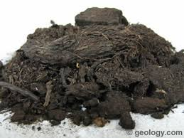
Nonrenewable Resources
Peat

Slide 12
Nonrenewable Resources
Stages of coal
2nd Stage
Lignite
Peat becomes compressed
Organic matter is pressed out
Soft and brown
70%carbon
Burns somewhat smoky and somewhat hot

Slide 13
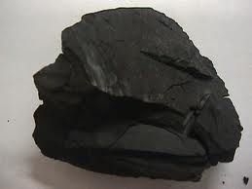
Nonrenewable Resources
Lignite

Slide 14
Nonrenewable Resources
Stages of coal
3rd stage
Bituminous
85% carbon
Called “soft coal”
Burns hot and less smoky that peat and lignite
Found in Pittsburg area

Slide 15
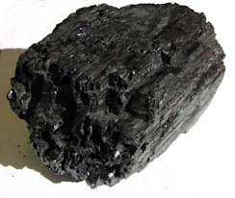
Nonrenewable Resources
Bituminous

Slide 16
Nonrenewable Resources
Stages of coal
4th stage
Anthracite
Very hard and black
Burns very hot and clean
90% carbon
Found in upstate PA

Slide 17
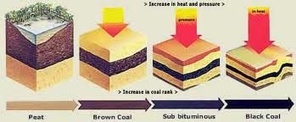
Nonrenewable Resources
Stages of coal formation

Slide 18
Nonrenewable Resources
Petroleum and Natural Gas
Made from the remains of plants, bacteria, algae and microscopic marine organisms
Commonly created in coastal marine waters
Chemical and physical reactions take place after remains are buried for millions of years

Slide 19
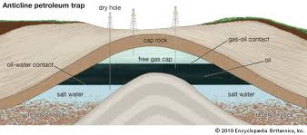
Nonrenewable Resources
Natural Gas and Petroleum

Slide 20
Renewable Energy Resources
A renewable resource can be replaced within the human lifespan
Often called alternative energy resources
Sun
Wind
Geothermal
Hydropower
Nuclear power
trash

Slide 21
Renewable Energy Resources
Solar Energy
Energy from the sun’s light and heat
Can be used to heat buildings and water and provide electricity
Passive solar heat
Solar cells
Solar thermal systems

Slide 22
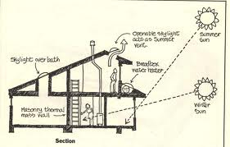
Renewable Energy Resources
Passive Solar Heating System

Slide 23
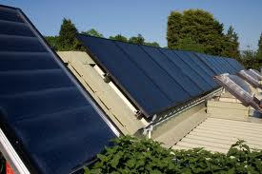
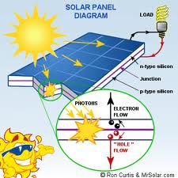
Renewable Energy Resources
Solar Cells

Slide 24
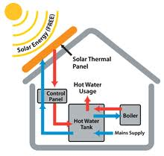
Renewable Energy Resources
Thermal Solar System

Slide 25
Renewable Energy Resources
Wind
Used in many developed countries to produce electricity
Blades on a wind turbine drive a generator
The faster the speed, the more electricity generated
Groups of turbines are called wind farms

Slide 26
Renewable Energy Resources
Hydropower
Harnessed energy from falling water
Used to generate electricity
Dams use hydroelectric
Clean, renewable, NO waste

Slide 27
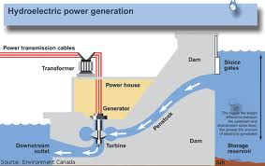
Renewable Energy Resources
Hydroelectric Power

Slide 28
Renewable Energy Resources
Geothermal Power
Heat inside of the earth
Can be used to create electricity
Availability is limited
Can be depleted

Slide 29
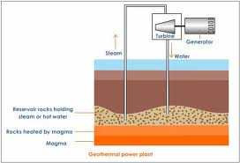
Renewable Energy Resources
Hot Dry Rock Method

Slide 30
Renewable Energy Resources
Biomass
Organic matter in plants and plant products
Litter from animals
Usually burned
Wood

Slide 31
Renewable Energy Resources
Waste
Can be burned
Gasses can be captured
Paper industry
Sugar industry

