Slide 1
Water
Jennifer Naples
Environmental Science

Slide 2
Water Resources
Water Usage in the United States
50% Industry
42% Agriculture
8% Residential

Slide 3
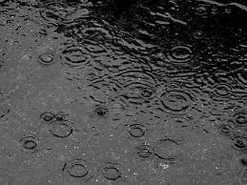
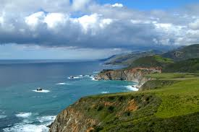
Water Resources
Water is a renewable resource
Constantly circulated by the water cycle

Slide 4
Water Resources
70% of the Earth’s surface is covered with water
97% salt water
3% fresh water
77% icecaps and glaciers
22% groundwater
1% other water (lakes, rivers, soil moisture, atmosphere)

Slide 5
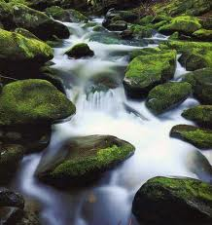
Water Resources
Surface Water
Fresh water that is above the ground
Lakes
Ponds
Rivers
Streams

Slide 6
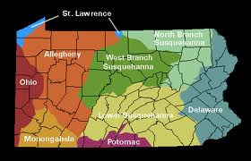
Water Resources
Watershed
Entire area of land that is drained by a river

Slide 7
Water Resources
Dams
Restricts the flow of water
Built across a river or stream
Water collects behind the dam and forms a reservoir or lake

Slide 8
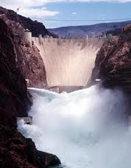
Water Resources
Hoover Dam - Nevada

Slide 9
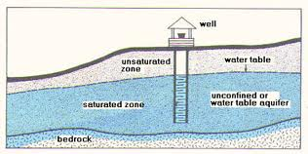
Water Resources
Groundwater
Water that seeps underground
Large amounts found in aquifers
Underground rock formations which collect water
Continuously receive water that percolates down from the surface
Running low

Slide 10
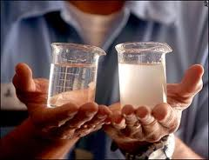
Water Resources
Solutions to water shortages
Desalination (Desalting the sea)
Removing the salt from sea water
Distillation
Reverse osmosis

Slide 11
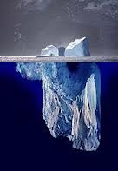
Water Resources
Towing Water
Transporting water from one place to another
Icebergs
Iceberg Hunters

Slide 12
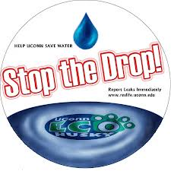
Water Resources
What are some things that you can do to conserve water?

Slide 13
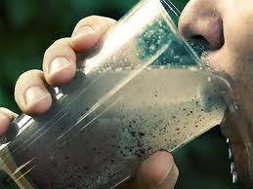
Water Pollution
What is water pollution?
The introduction of
Chemical
Physical
Biological
Agents into the water that degrades the quality of the water and affects the organisms that depend on it

Slide 14
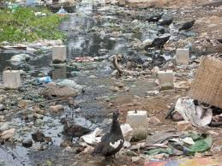
Water Pollution
Water pollution has two underlying causes
Industrialization
Human population explosion

Slide 15
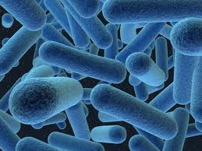
Water Pollution
Types of pollutants
Pathogens
Disease causing organisms such as bacteria

Slide 16
Water Pollution
Pathogens
Enter water supplies in untreated wastewater or animal feces
Can cause many diseases through drinking water
Cholera, hepatitis and typhoid
Public water routinely monitored by fecal coliform test(tests for Escherichia coli, an intestinal bacteria)

Slide 17
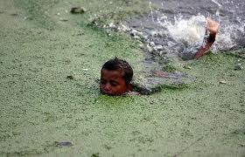
Water Pollution
Types of pollutants
Organic matter
Biodegradable remains of animals and plants including feces

Slide 18
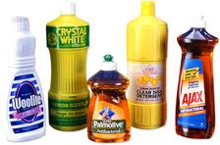
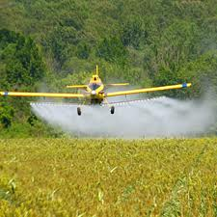
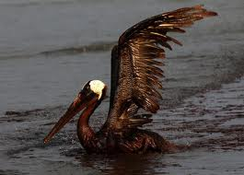
Water Pollution
Types of pollutants
Organic chemicals
Pesticides, fertilizers, plastics, detergents, gasoline, oil and other materials that come from fossil fuels

Slide 19
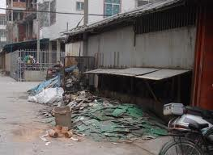
Water Pollution
Types of pollutants
Inorganic chemicals
Acids, salts and toxic metals

Slide 20
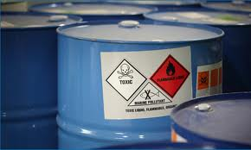
Water Pollution
Types of pollutants
Toxic chemicals
Chemicals that are poisonous to living things
Formaldehyde
Arsenic
Cyanide

Slide 21
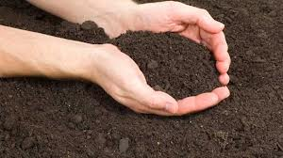
Water Pollution
Types of pollutants
Physical agents
Heat and suspended solids such as soil

Slide 22
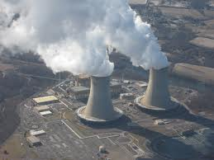
Water Pollution
Types of pollutants
Radioactive waste
From power plants, nuclear processing and defense facilities
Limerick Nuclear Power Plant

Slide 23
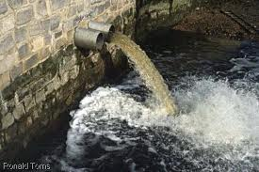
Water Pollution
Point Pollution
Pollution that is discharged from a single source
Easy to identify and regulate
Difficult to enforce cleanup
Wastewater plant
Factory
Oil tanker

Slide 24
Water Pollution
Nonpoint pollution
Comes from many sources
Reaches bodies of water through many avenues
Accumulation of small amounts adds up to a huge problem
Streets
Storm sewers
Homes, lawns, farms

Slide 25
Water pollution
Create a flipchart comparing point and nonpoint pollution.
Define each term
Give examples of each
Make a diagram to help you remember

Slide 26
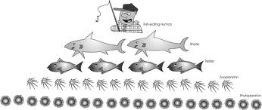
Water Pollution
Affects on Ecosystems
Biological Magnification
Increase in concentration of harmful substances as it gets moved up the food chain

Slide 27
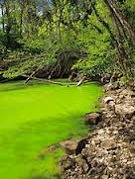
Water Pollution
Artificial Eutrophication
Abundance of nutrients
Occurs naturally over a long period of time
Process accelerated by sewage and fertilizer runoff

Slide 28
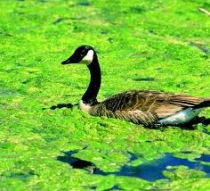
Water Pollution
Artificial Eutrophication
Phosphorous from detergents, animal waste and fertilizers cause excessive growth of algae
Algae forms large mats called algal blooms that float on the water
When algae dies and decomposes, large amounts of dissolved oxygen are used
Fish suffocate

Slide 29
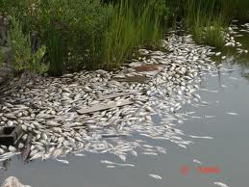
Water Pollution
Thermal Pollution
Excessive amounts of heat are added to a body of water.
Usually water used to cool power plants or other industries
Causes massive “fish kills”

Slide 30
Water Pollution
Thermal Pollution

Slide 31
Wastewater Treatment Plants
Most of the water that goes down the drain is wastewater and flows through pipes into a wastewater treatment plant
Water is treated and returned to a river or lake
Not all harmful substances are removed

Slide 32
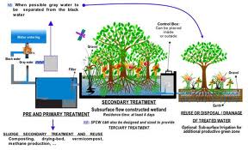
Wastewater Treatment Plants

