Slide 1
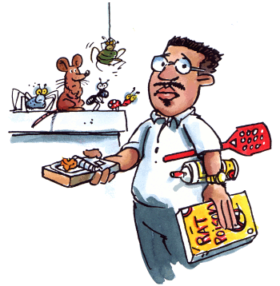
IPM
I – Integrated P – Pest M - Management

Slide 2
What is IPM?
Pest control founded on the principles of ecology.
A process you can use to solve pest problems while minimizing risks to people and the environment.

Slide 3
IPM Principles
IPM is an environmentally sensitive approach that uses a combination of common-sense practices to manage pests.
Knowledge of pest biology and habitats are used to select the best combination of common-sense practices that will keep pests under control.
IPM uses a series of steps that result in making pest management decisions that control the pests with the least effect on people, pets and the environment.

Slide 4
IPM Background
Understanding the needs of pests is essential to implementing IPM effectively.
Pests seek habitats that provide basic needs such as air, water, food and shelter. Pest populations can be prevented or controlled by creating inhospitable environments, by removing some of the basic elements pests need to survive, or by blocking their access to an area.
Habitat modification may be used in combination with traps, vacuums, biological control or pesticides. An understanding of what pests need in order to survive is essential before action is taken.
Anticipating and preventing pest activity in combination with several pest control methods can achieve long-term results.

Slide 5
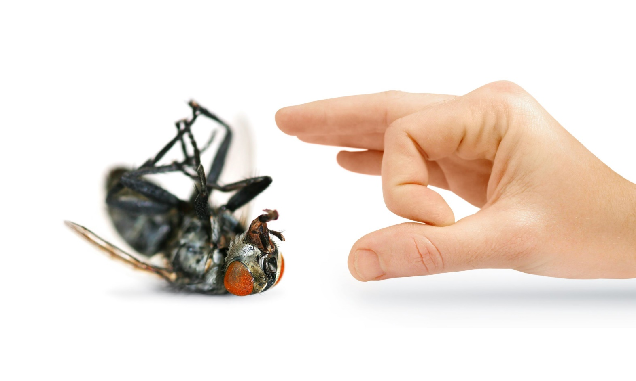
What is a Pest?
A pest is any unwanted animal or plant which has a harmful effect on humans, their food or their living conditions.
There are thousands of different kinds of pests, the great majority of these are types of insects.

Slide 6
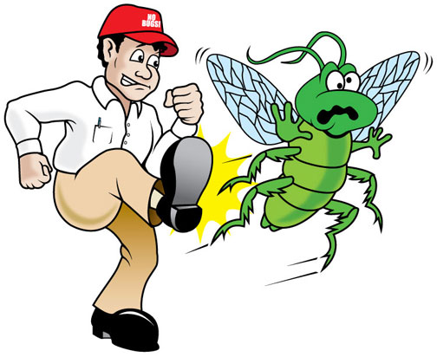
Categories of Pests
Regular Pest – frequently occurs
Occasional Pest – infrequently occurs
Seasonal Pest – occurs during a particular season every year
Persistent Pest – occurs throughout the year and is difficult to control
Sporadic Pest – occurs in an isolated location during some period

Slide 7
What is a Pesticide?
A pesticide is any substance that is used to prevent, destroy, or repel pests or reduce the damage pests cause.
Pesticides can target insects (insecticides), rats and mice (rodenticides), weeds (herbicides) and fungi (fungicides).
Pesticides even include common household disinfectants like bleach or bathroom cleaner that kill bacteria.

Slide 8
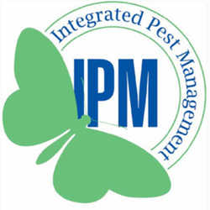
The IPM Process
The IPM approach uses a basic decision-making process. This process helps determine if treatment is necessary, where to treat, when to treat, and which strategies are best to use. The steps taken to determine a treatment plan are the same regardless of the environment or the type of pest.
IPM follows the six basic steps listed below:
Identify
Learn pest and host life cycles and biology
Monitor and sample for pest populations
Establish action threshold
Choose tactics
Evaluate results

Slide 9
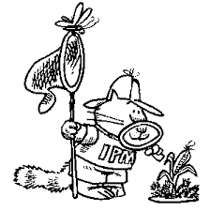
Step 1: Inspect & Identify
Correctly identifying the cause of the problem and/or the responsible pest will result in the most effective treatment plan.

Slide 10
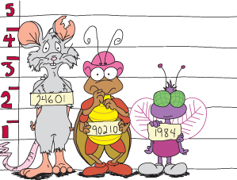
Step 2: Learn pest and host life cycles and biology
Once the pest is identified, read about its life-cycle, food sources, preferred habitats, special adaptations, and natural enemies.
The best management plan will take all of these factors into account.

Slide 11
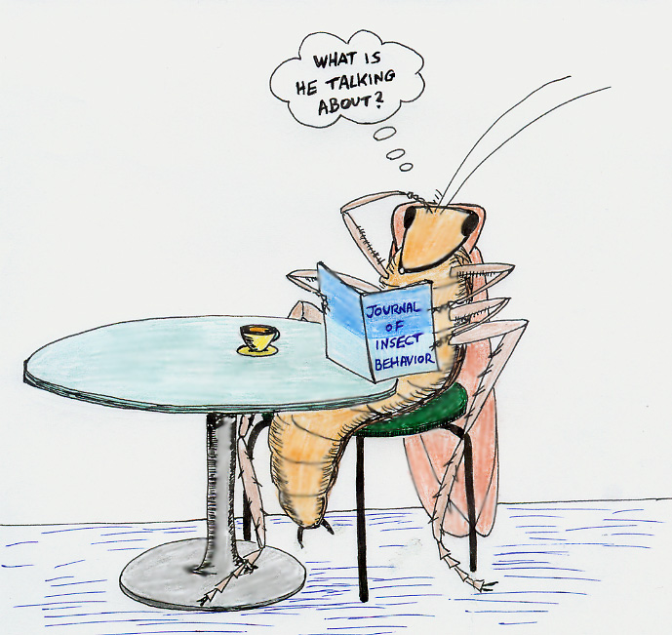
Step 3: Monitor
The regular and ongoing inspection of areas where pest problems are occurring or could occur.
Monitoring helps to determine where and when treatment is needed, helps to pinpoint problem areas, and allows you to evaluate and fine tune treatments.

Slide 12
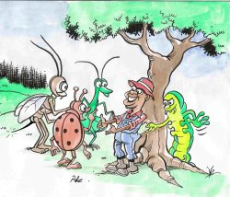
Step 4: Establish action threshold (economic, health, or aesthetic)
In some situations a certain number of pests can be tolerated. However, there may come a time when something must be done.
When human health is a consideration, action thresholds are low. This means that only a few pests are necessary to start a pest management program.

Slide 13
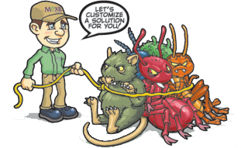
Step 5: Choose Tactics
IPM emphasizes prevention by identifying and removing the causes of the problems, rather than just treating the symptoms.
The information gathered in the previous steps should be used to select the best control methods (IPM Tactics) for a particular situation. Treatment strategies should be:
Least hazardous to human health
least disruptive to natural controls
least toxic to non-target organisms
most likely to be permanent and prevent recurrence of the pest
cost-effective
appropriate to the site

Slide 14
Step 6: Evaluate Results
After the control methods have been applied, this step provides an opportunity to evaluate their effectiveness.
The evaluation is based on answers to specific questions.
Was the pest managed or prevented to your satisfaction?
Was the method satisfactory?
Were there any unintended side effects?
What will you do in the future for this pest situation?

Slide 15
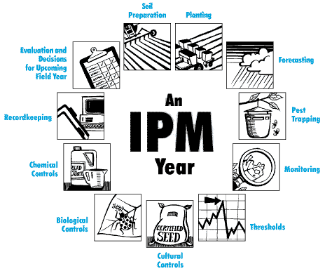
IPM in a Nutshell
Be prepared
Think prevention
No surprises
Think strategy
Choose and use
Think again

Slide 16
IPM Tactics
Multiple tactics are used to keep pest populations off-balance and avoids development of resistance to pesticides. Least toxic methods are used before more toxic ones whenever possible.
The categories of tactics include:
Cultural – minimize conditions needed to live
Physical – prevent access to host area or physically remove
them
Genetic – use pest-resistant varieties
Biological – use predators, parasites, and diseases to suppress
pest populations
Chemical – biorational and conventional
Regulatory – government agencies try to stop the spread or entry of pests into an area

Slide 17
Benefits of IPM
The IPM method encourages reduced reliance on pesticides and when used recommends the least toxic, most specific product.
The goal is to avoid the pesticide problems that became apparent in the 1960’s, including human and environmental health problems, food contamination, pesticide resistance, and damage to beneficial organisms.
While IPM has some drawbacks, these pest control methods are much safer for people and the environment.

Slide 18
IPM Summary
IPM (Integrated Pest Management) uses solid science and sound solutions in dealing with pests.
IPM promotes safe, least-toxic solutions to both pest and pesticide problems.

Slide 19
IPM Summary
What can IPM do?
IPM helps deal with pests – insects, plant diseases, weeds, and more – with methods that help keep health and environmental risks as low as possible while saving money.

Slide 20
IPM Summary
What’s in a name?
IPM is integrated because it brings together, or integrates, a range of biological, organic, cultural, mechanical, and chemical options for pest problems. It rarely relies on just one tactic – it integrates tactics to prevent pests entirely or reduce them to levels you can live with.
IPM used to focus on insect pests, the range now includes fungi, bacteria, viruses, weeds, wildlife, and more.
IPM is about management because pests can only be managed – pests can’t be eliminated, no matter what someone might say.

Slide 21
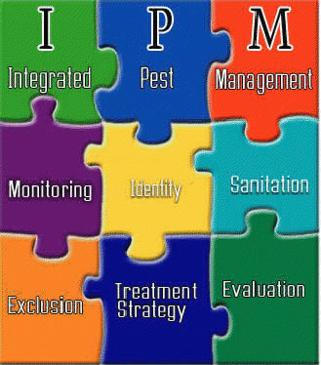
Good science. Good sense. IPM.

