Slide 1
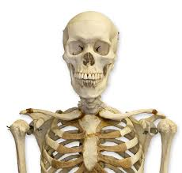
Skeletal System

Slide 2
An adult skeletal system is made up of 206 bones.
Bones serve the following functions (purposes):
1. supporting framework
2. area for muscles to attach
3. protect organs
4. storehouse for minerals
5. center for production of RBC and some white

Slide 3
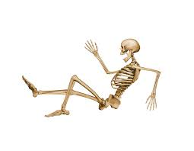
COMPOSITON OF BONE TISSUE:
1. LIVING CELLS
2. HARD MINERALS
A. CALCIUM PHOSHATE
B. CALCIUM CARBONATE

Slide 4
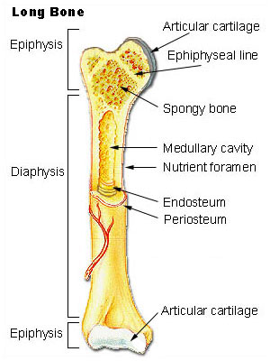
Structure of Bone:
1. Joint: place where bones meet
2. Periosteum: hard outer layer
3. Articular Cartilage: covers the ends of bone:
smooth for sliding
4. Spongy Bone: ends of bone, absorbs shock; contains red marrow and produces red blood cells
5. Medullary Canal: middle of shaft; contains yellow marrow

Slide 5
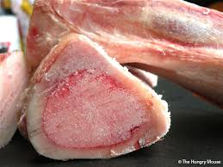
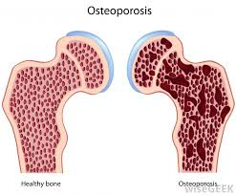
7. Haversian Canal: channels which contain blood vessels
which supply nourishment to bone cells
8. Epiphyseal Line: growth plate
9. Marrow: soft layer in hollow of bone
> red-ends of bone
> yellow- fat cells
10. Osteoporosis:
‘brittle bones’

Slide 6
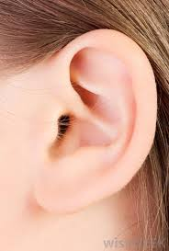
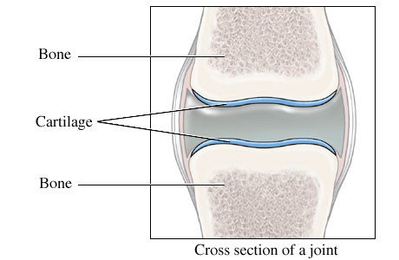
Permanent Cartilage:
Ears
Back : In between vertebrae
Ribs
Nose-septum
Larynx
Trachea
Articular Cartilage: end of bones

Slide 7
BUILDING BONE TISSUE:
Three conditions necessary for growth and hardening of bone:
Adequate supply of minerals: calcium, phosphorus
Chemical substances need to be present for bone cells
to make use of minerals
Hormones needed for proper growth
Bones store the body’s supply of phosphorus and calcium.
Bones become stronger with use!

