Slide 1
Chapters Six and Five
The Mathematics and Classification of Chemical Reactions

Slide 2
5.1 Chemical Equations
Chemical equation: a concise way to show the “before and after” of a chemical reaction.
Reactants: the “before”
Products: “after” the reactants “swap” atoms around.
3 H₂ + N₂ → 2 NH₃

Slide 3
5.1 Chemical Equations
Law of conservation of matter: Matter can neither be created nor destroyed… only changed in form.
We must “balance” chemical equations in order to reflect this law.

Slide 4
Numbers in front of formulas are called coefficients, they multiply all the atoms in a formula.
They are used to “balance” the equation… to show that no atoms were created or destroyed
2 Na₂CO₃ indicates two units of sodium carbonate, which contains 4 Na, 2 C, and 6 O.
Substances involved in chemical reactions may be designated as solids (s) , liquids (l) , gases (g) , or they may be aqueous (dissolved in water) (aq).

Slide 5
5.2 Balancing Chemical Equations
The written out steps are in your text book. Let’s just do examples:

Slide 6
5.2 Balancing Chemical Equations
NaBr + Cu₃(PO₄)₂ → Na₃PO₄ + CuBr₂

Slide 7
C₃H₈ + O₂ → CO₂ + H₂O

Slide 8
aluminum carbonate + iron(II) nitrate →
aluminum nitrate + iron(II) carbonate

Slide 9
6.1 Avogadro’s Number and the Mole
This was taught in chapter 8. The slides for this section are at the end of this file if you need a refresher.

Slide 10
6.3 Calculating the AMOUNTS of substances in chemical reactions:
Stoichiometry!
“Stoichiometry” involves mathematically predicting…
the amount of one substance that reacts away or is produced during a reaction…
based on the amount of a different substance in the same reaction.

Slide 11
6.3 Stoichiometry
The basis for these predictions is the “recipe” of the reaction…
the balanced equation!

Slide 12
6.3 Stoichiometry
The basis for these predictions is the “recipe” of the reaction…
the balanced equation!

Slide 13
6.3 – 6.4 Stoichiometry Problems
See your textbook if you want step-by-step instructions… we’re just going to work examples ‘til we can’t breathe! ☺
But keep in mind: the coefficient ratios in balanced equations ONLY WORK WITH MOLES of substances, not grams!

Slide 14
1. How many moles of NH₃ can be produced from 5.00 moles of H₂ reacting with an excess of N₂?
N₂ + 3 H₂ → 2 NH₃

Slide 15
2. How many moles of oxygen are needed to react away 75.0 g of propane (C₃H₈)?
C₃H₈ + 5 O₂ → 3 CO₂ + 4 H₂O

Slide 16
3. If you want to produce 100.g of CO₂, how many grams of O₂ will be needed to react with an excess of propane to accomplish this task?
C₃H₈ + 5 O₂ → 3 CO₂ + 4 H₂O

Slide 17
4. 0.50 L of nitrogen gas at 20.°C and 1.01 atm is reacted with an excess of hydrogen gas. How many grams of ammonia (NH₃) should be produced?
N₂ + 3 H₂ → 2 NH₃

Slide 18
5. How many liters of CO₂ gas are produced, at STP, when 25.0 g of Na₂CO₃ are reacted with an excess of HCl? H₂O and NaCl are the other products of the reaction.

Slide 19
6.5 Limiting Reagent
The reactant that “runs out” first is the “limiting reagent”.
Once it runs out, the reaction stops
How do you know which one runs out first??
Option 1: you’re told that one reactant is “in excess”, so the other one will run out first.

Slide 20
But what if you’re NOT told which reactant runs out first??
Option 2: you’re given starting amounts of BOTH reactants, and you must compare how much of one reactant you HAVE to how much of that reactant is NEEDED to react away the other reactant.

Slide 21
6. 24.0 g of LiBr are reacted with 18.0 g of CaSO₄. Which reactant is the limiting reagent (will run out first)?
2 LiBr + CaSO₄ → Li₂SO₄ + CaBr₂

Slide 22
7. Now predict how many grams of lithium sulfate should be produced by the previous reaction.
2 LiBr + CaSO₄ → Li₂SO₄ + CaBr₂

Slide 23
“Intro to Chemical Reactions” Lab
Determine the Limiting Reagent of your reaction.

Slide 24
“Intro to Chemical Reactions” Lab
Calculate the theoretical yield of calcium carbonate in your reaction.
In other words, use the amount of your limiting reagent to predict how many grams of calcium carbonate product should have been produced by the reaction.

Slide 25
6.5 Percent Yield of a Reaction
% Yield = experimental yield x 100
theoretical yield

Slide 26
The experimental yield is the mass of the product actually made in the lab.
The theoretical yield is the mass of that product that SHOULD have been produced of that product…
Do a stoichiometry problem to see how much product SHOULD have been made.

Slide 27
6. When 35 g of H₂ were reacted with excess N₂, it was found that 181 g of NH₃ were produced. What is the percent yield of this reaction?
N₂ + 3 H₂ → 2 NH₃

Slide 28
“Intro to Chemical Reactions” Lab
Calculate the percent yield of calcium carbonate in your reaction.

Slide 29
End of Chapter 6
End of Material
Covered on the Midterm

Slide 30
5.3 Classes of Chemical Reactions
Precipitation reactions
Acid–base neutralization reactions
Oxidation–reduction reactions (redox reactions, for short)

Slide 31
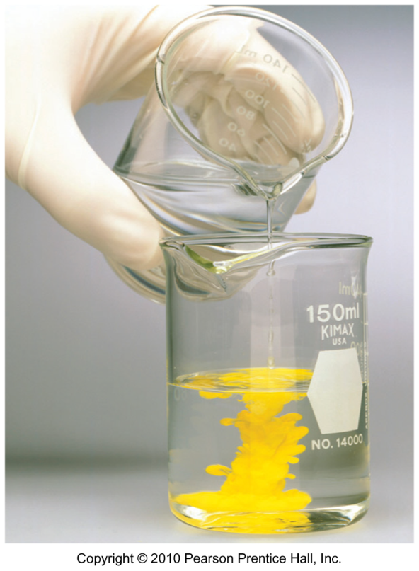
5.4 Precipitation Reactions and Solubility Guidelines
Precipitation reactions are processes in which an insoluble solid called a precipitate forms when aqueous reactants are combined.

Slide 32
5.4 Precipitation Reactions and Solubility Guidelines
Goals:
To predict whether a precipitation reaction will occur
How: By determining the solubility of the potential products.

Slide 33
“Soluble Ion” Lists
Compounds containing any of the following cations are always SOLUBLE
NH₄⁺ (ammonium)
Li⁺
Na⁺
K⁺
Rb⁺

Slide 34
“Soluble Ion” Lists
Compounds containing any of the following anions are always SOLUBLE
NO₃⁻ (nitrate)
CH₃CO₂⁻ (acetate)
ClO₄⁻ (perchlorate)

Slide 35
“Soluble Ion” Lists
Compounds containing the following ions are usually SOLUBLE
Cl⁻, Br⁻, I⁻ (EXCEPT with Hg₂²⁺, Pb²⁺ and Ag⁺)
SO₄²⁻ (EXCEPT with Hg₂²⁺, Pb²⁺ and Ba²⁺)

Slide 36
5.4 Solubility Rules
Write soluble or insoluble next to each ionic compound
K₂SO₄ ________ CoCl₂ ________
AgBr ________ Pb(CH₃CO₂)₂ ________
BaCl₂ ________ Ca(OH)₂ ________

Slide 37
“Soluble Ion” Lists
If a combination of ions is mixed that would NOT be soluble in water, those ions will combine (according to their charges) and form a precipitate.

Slide 38
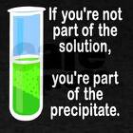
As the saying goes…
…
?

Slide 39
As the saying goes…

Slide 40
5.4 Precipitation Rxn. Storyboard
Pb(NO₃)₂ ₍ ₎ + FeCl₂ ₍ ₎ → PbCl₂ ₍ ₎ + Fe(NO₃)₂ ₍ ₎

Slide 41
5.4 Precipitation Rxn. Storyboard
Pb(NO₃)_{2 (aq)} + FeCl_{2 (aq)} → PbCl_{2 (aq)} + Fe(NO₃)_{2 (s)}

Slide 42
5.4 Determining Potential Products of Precipitation Reactions
The potential products result from combining the cation of one reactant with the anion of the other… and vice versa.
Only combine ONE of each ion, at first
Then CHECK CHARGES to determine the correct formulas of the two “products”

Slide 43
Predict the potential products of the following:
Na₂SO_{4 (aq)}+ AlPO_{4 (aq)} →
AgNO_{3 (aq)}+ FeBr_{3 (aq)} →

Slide 44
Now determine if any of the potential products actually forms as a precipitate (is NOT soluble in water):
Na₂SO_{4 (aq)}+AlPO_{4 (aq)} → Na₃PO₄ ₍ ₎ + Al₂(SO₄)₃ ₍ ₎
AgNO_{3 (aq)}+ FeBr_{3 (aq)} → AgBr₍ ₎ + Fe(NO₃)₃₍ ₎

Slide 45
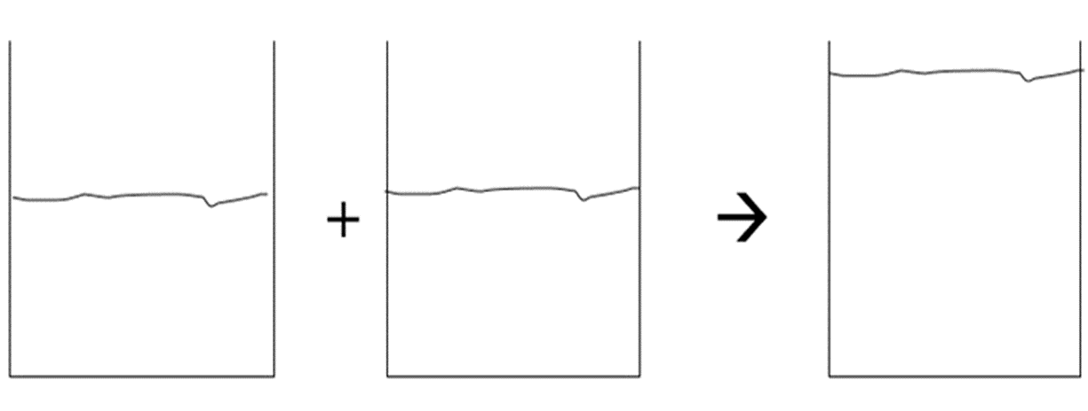
“NO Reaction” Storyboard
3Na₂SO_{4 (aq)} + 2AlPO_{4 (aq)} → 2Na₃PO_{4 (aq)}+ Al₂(SO₄)_{3 (aq)}

Slide 46
5.8 Net Ionic Equations
Spectator ion: An ion that stays dissolved and does not precipitate.
Net ionic equation: A balanced equation that only includes the ions involved in the precipitation…
the spectator ions have been removed.

Slide 47
3Pb(NO₃)_{2 (aq)}+ 2FeCl_{3 (aq)} → 3PbCl_{2 (s)} + 2Fe(NO₃)_{3 (aq)}
Pb²⁺ Fe³⁺ Fe³⁺ NO₃⁻
NO₃⁻ + Cl⁻ → NO₃⁻ NO₃⁻
NO₃⁻ Cl⁻ Cl⁻
PbCl₂
Net ionic equation:

Slide 48
5.5 Acids, Bases, and Neutralization Reactions
Review: How to identify acids and bases

Slide 49
5.5 Acids, Bases, and Neutralization Reactions
When acids and bases are mixed together, they “neutralize” each other’s properties.
These are ALSO “double swap” reactions… but water is made instead of a precipitate.
Names and formulas of acids are on p. 92 (for your reference… you don’t need to memorize.)

Slide 50
A neutralization reaction produces water and a dissolved salt (ionic compound).
HA_{(aq)} + MOH_{(aq)} → H₂O_{(l)} + MA_{(aq)}
acid + base → water + salt
Where “M” is some metal cation, and “A” is the anion left after the H⁺ from the acid leaves

Slide 51
Predict the products and balance the equation for this neutralization reaction:
H₃PO_{4(aq)} + Ca(OH)_{2(aq)} →

Slide 52
5.6 – 5.7 Redox Reactions
Oxidation– reduction (redox) reaction: A reaction in which electrons transfer from one reactant to another.

Slide 53
5.6 – 5.7 Redox Reactions
The oxidation number (state) of an atom indicates how “electron rich” or “electron poor” the atom currently is.
By comparing the oxidation states of the atoms before and after reaction, we can tell which atoms have gained and lost electrons (if any!).

Slide 54
Oxidation: Loss of one or more electrons by an atom.
it actually has nothing to do with the element oxygen.
the oxidation number will INCREASE
(this is the easiest way to see if a reactant has oxidized)

Slide 55
Reduction: The gaining of electrons by an atom.
Causing the oxidation number of that atom to DECREASE (reduce)

Slide 56
Redox Reactions
A simple mnemonic:
LEO the lion goes GER

Slide 57
Redox Reactions
A simple mnemonic:
LEO the lion goes GER
Loss of Electrons is Oxidation

Slide 58
Redox Reactions
A simple mnemonic:
LEO the lion goes GER
Gain of Electrons is Reduction

Slide 59
Oxidation and reduction always occur together.
The substance that is oxidized is also known as the reducing agent.
The substance that is reduced is also known as the oxidizing agent.

Slide 60
What substance is oxidized? ____________
What substance is reduced? ____________
What is the oxidizing agent? ____________
What is the reducing agent? ____________

Slide 61
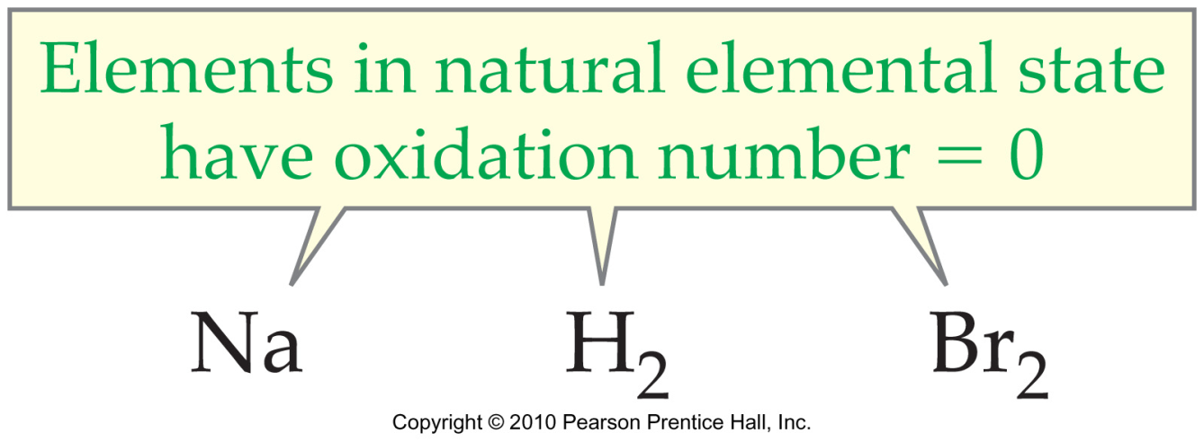
Rules for assigning oxidation numbers:
A monatomic ion has an oxidation number equal to its charge.

Slide 62
In covalent compounds:
Hydrogen is always +1
the more electronegative atom gets its “normal” charge as its oxidation number.
The other atom gets an oxidation number such that the total charge is correct.
Examples:

Slide 63
End of Chapter Five

Slide 64
6.1 Avogadro’s Number and the Mole
A “Mole”: As “dozen” is just a word that means the number “12”, “mole” is a word that means 602 sextillion
Avogadro’s number: The number of things in a mole. N_{A} = 6.02 x 10²³

Slide 65
Mole “Fast Facts”
6.02 X 10²³ Watermelon Seeds…
Would be found inside a melon slightly larger than the moon.
6.02 X 10²³ inches…
1,616,434 light years, or 8 round-trips across our galaxy and back

Slide 66
Mole “Fast Facts”
6.02 X 10²³ of oranges spread over the entire surface of the earth would create a layer of oranges to a depth of ____________miles.
~ 45 oranges per bushel
1 bushel = 0.035 m³ ( 35 L)
Surface area (total) of earth = 5.1x10¹⁴ m²
1609 meters = 1 mile

Slide 67
6.1 Avogadro’s Number and the Mole
Molar mass: The mass of one mole of that substance…
Same numeric value as Formula mass, but in grams

Slide 68
6.1 Avogadro’s Number and the Mole
The formula mass of CO₂ = __________
The molar mass of CO₂ = __________

Slide 69
6.1 Avogadro’s Number and the Mole
The formula mass of Ca(NO₃)₂ __________
The molar mass of Ca(NO₃)₂ __________

Slide 70
6.2 Gram ←→ Mole Conversions
Molar mass serves as a conversion factor between numbers of moles of a substance and its mass.

Slide 71
6.2 Gram ←→ Mole Conversions
Example: how many moles of water molecules are in 25.0 grams of water?
Estimate:
Calculate:
(How many actual water molecules is that?)

Slide 72
6.2 Gram ←→ Mole Conversions
Example: how many grams of Cu(NO₃)₂ are in 0.120 mol of Cu(NO₃)₂ ?

Slide 73
“Intro to Chemical Reactions” Lab
Convert your grams of CaCl₂ to moles
Convert your grams of Na₂CO₃ to moles

