Slide 1
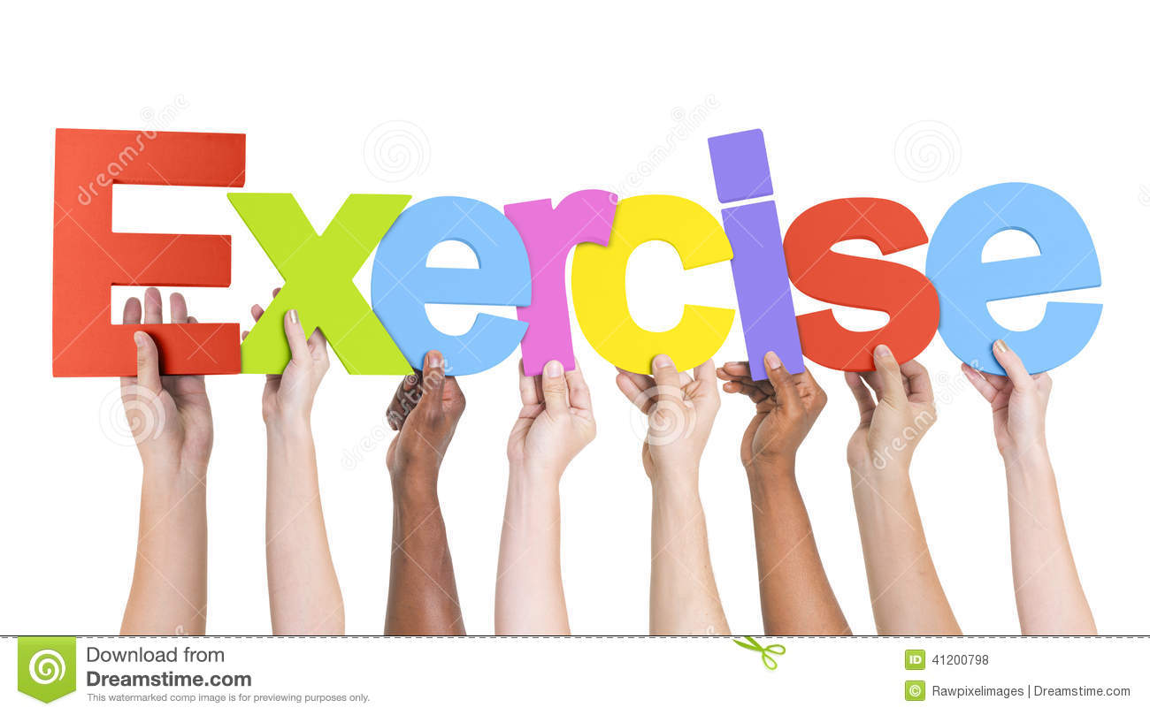
Muscular System

Slide 2
Label the Various Muscles:

Slide 3
Over 700 muscles you just need to know these:
Muscles you need to know:
1. sternocleidomastoid 11. Quadriceps
2.Trapezius 12. Sartorus
3. Lattisimus Dorsi 13. Hamstrings
4. Pectorals 14. Gastrocnemius
5. Tricep 15. Soleus
6. Bicep 16. Tibialis Anterior
7. Obliques 17. Flexors
8. Abdominals 18. Extensors
9. Deltoid *19. Iliopsoas
10. Gluteals

Slide 4
More muscles….

Slide 5
Muscle Movement and Location
A- Extensors Pulls hand (metacarpals) back Forearm back
B-Bicep Flex lower arm Front upper arm
C- Deltoid Raises upper arm(humerus) Shoulder
D-Trapezius Raises shoulders Upper middle back
E- Latissimus dorsi Lowers upper arm (humerus) Side of middle back
F- Gluteals Bring upper leg back Buttocks
G-Hamstings Flex lower leg Back upper thigh
H- Gastrocnemius Points toes Back of lower leg (calf)
I-Tibialis Anterior Pulls toes toward shin(tibia) Front lower leg

Slide 6
Muscle Movement and Location
J- Quadriceps extends lower leg Front upper leg (thigh)
K-Sartorius(diagonal extends lower leg Front upper leg
L- Iliopsoas flexes upper leg Hip flexor
M-Abdominals flex upper body Front stomach area
N-Obliques twist trunk Side middle stomach
O- Serratus stabilizes scapula upper rib area
P-Pectorals upper arm across chest Upper chest
Q-Triceps Extends lower arm Back upper arm
R-Sternocleidomastoid turns head side to side Neck
S-Flexors Flex(brings hand(metacarpals)in lower arm front

Slide 7
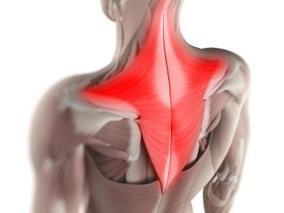
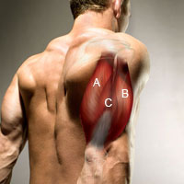
Muscles:
Muscles are named by their:
1. shape
2. location
3. number/amount
4. functions/movement

Slide 8
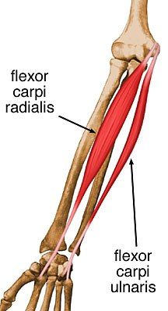
Location and Movement/Function:

Slide 9
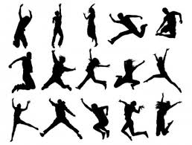
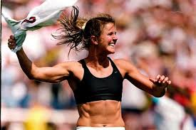
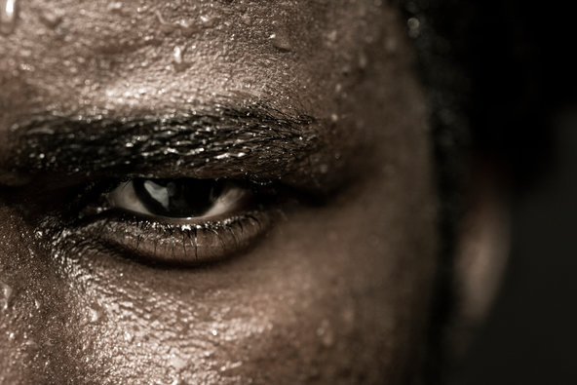
Function:
What is their job/function:
1.movement
2. shape
3.provide heat

Slide 10
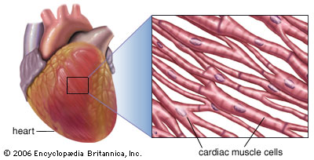
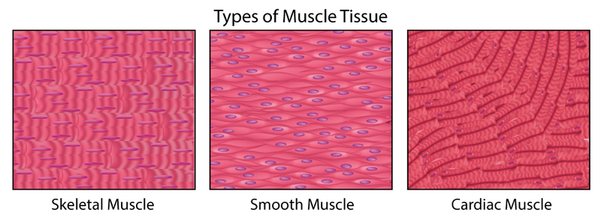
Types:
1. cardiac : heart (involuntary)
2.smooth: stomach/organs(involuntary)
3.striated: skeletal (voluntary) bicep, tricep

Slide 11
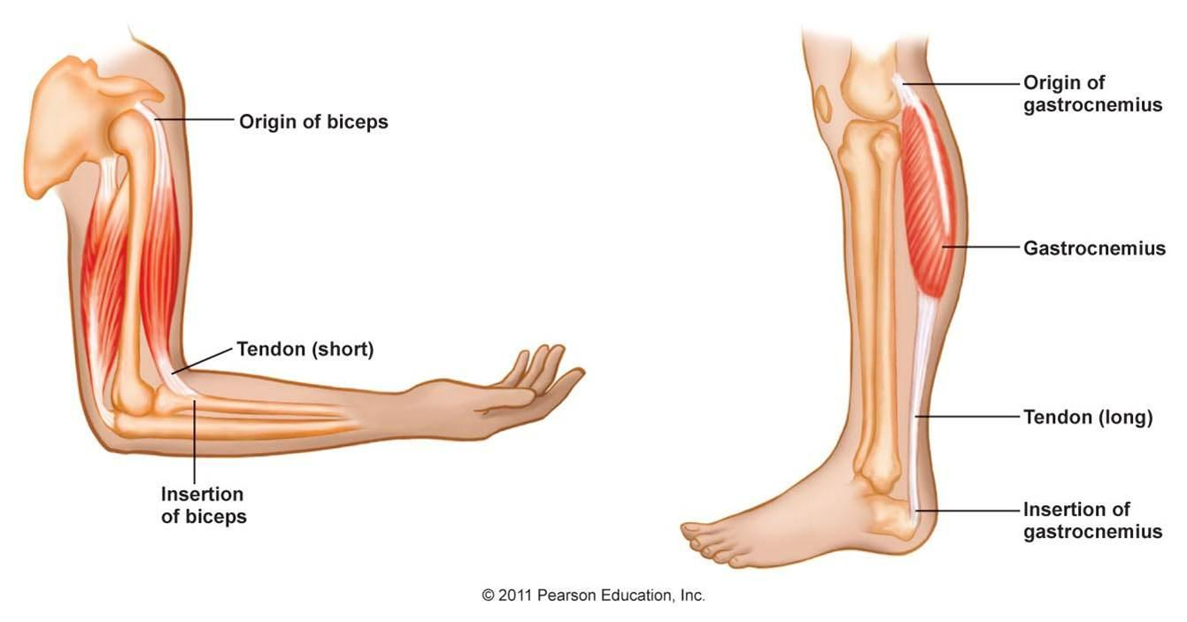
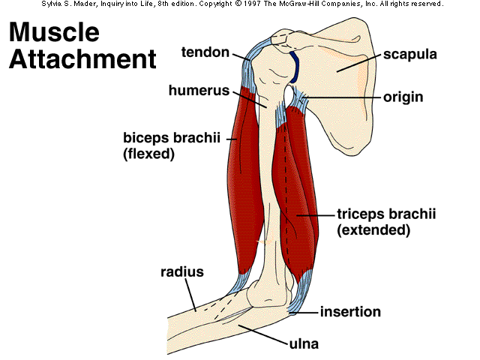
Muscles
Tendon: connects muscle to bone
Contraction: shorten/flex
Origin: point of attachment-no movement
Insertion: point of attachment-movement

Slide 12
Muscle Movements:
Flexion: shorten(bend)bicep Extension: Lengthen/straighten-tricep
Abduction: away from body Adduction: towards body
Pronation: palms up Supination: palms up
Rotation: circular motion

