Slide 1
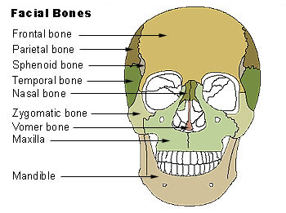
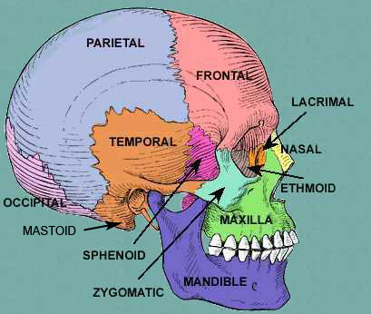
BONES OF THE SKULL
There are eight bones that surround your brain: one frontal bone; two parietal bones, two temporal bones, one occipital bone, one sphenoid bone and one ethmoid bone. These eight bones make up the cranium. Another 14 bones in the face make up the entire skull. There are also three small bones in each ear. 28 total bones in the skull!

Slide 2
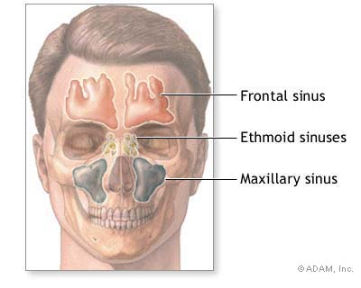
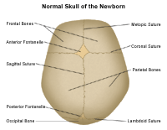
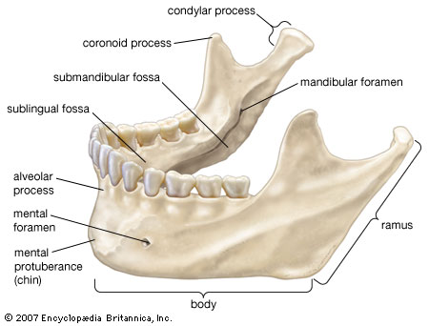
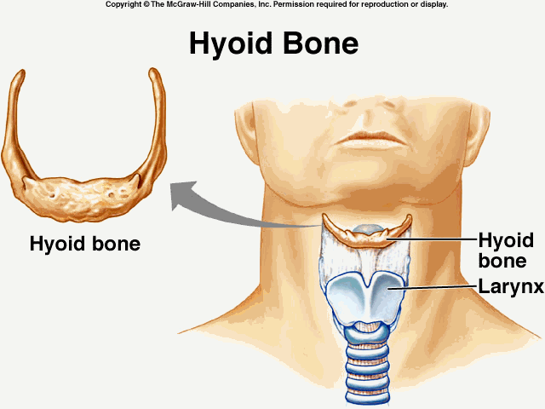
THE SKULL:
1. Sutures- where cranial bones connect (lines).
2. Mandible- jaw bone
3.Hyoid Bone- ‘U’ shaped bone in neck that supports tongue
4.Sinuses- air cavities

Slide 3
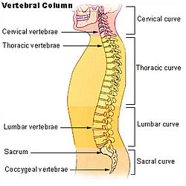
THE VERTEBRAL COLUMN:
THE SPINAL COLUMN IS MADE UP OF 32 BONES-8 ARE FUSED TOGETHER
1. CERVICAL: #’S 1-7
2. THORACIC: #’S 8-19
3. LUMBAR: #’S 20-24
4. SACRUM: 6 FUSED TOGETHER
5. COCCYX: 2 FUSED TOGETHER

Slide 4
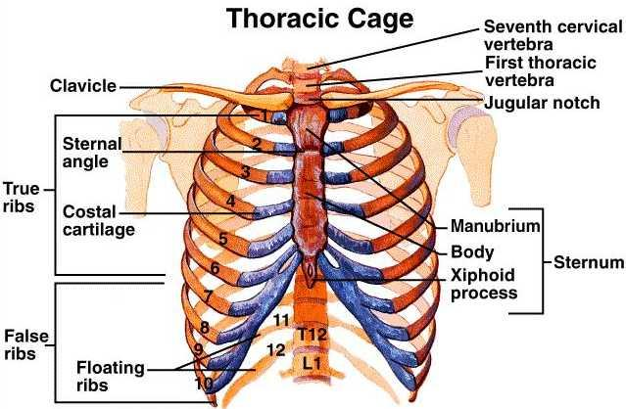
RIBS:
There are 12 pair of ribs:
1. First 7 are called TRUE RIBS- they attack directly to the sternum.
2. The rest of call FALSE RIBS and FLOATING RIBS because they either attach to cartilage and then to the sternum or they are just attached to the back bone.

