Slide 1
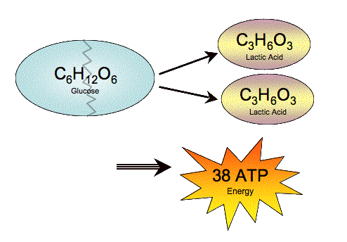
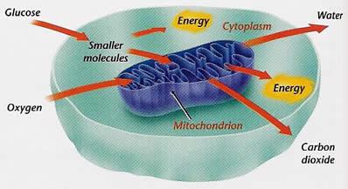
Energy For Muscles
Glucose + Oxygen = Energy to contract muscles and produce heat
Glucose: stored in the muscles as glycogen
Oxygen: used to burn glucose into energy
Glucose + O2 = Energy for contraction and heat

Slide 2
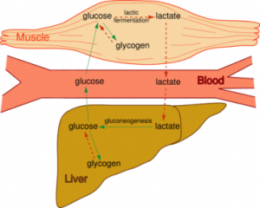
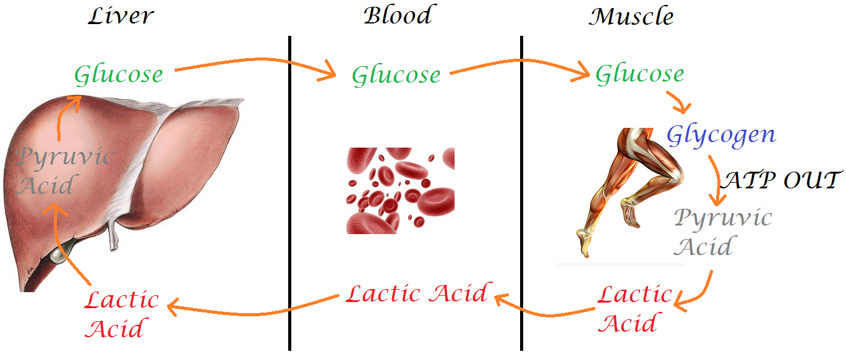
Waste Products produced are CO2 and H20
1. Carbon Dioxide and Water: waste products from the production of
Energy for muscles
2. Lactic Acid: builds up in the muscles from lack of oxygen
(without O2, glucose breaks down into lactic acid)
Achy and sore muscles are caused by lactic acid build up

Slide 3
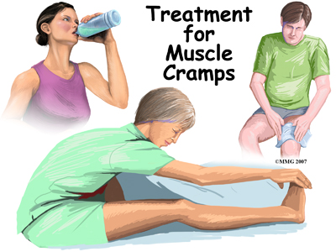
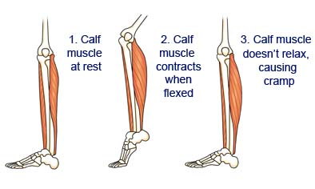
Muscle Injuries and Diseases
Muscle Cramps:
-spontaneous, often painful muscle contractions
a. Cause- prolonged exercise or dehydration
b. Treatment- stretch, ice, fluid

Slide 4
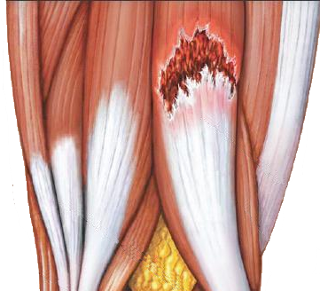
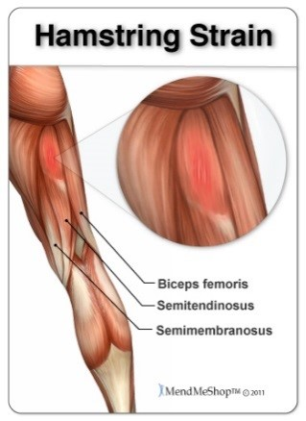
Muscle Strain/Tear-
Painful injury that involves the tearing of muscle fibers
Cause: Traumatic injury or overuse
Treatment: rest and ice

Slide 5
Tendinitis: Inflammations of the tendon
Cause: injury, overuse or aging
Treatment: proper warm up, avoid over-use, ice
Shin Splints: pain in the front of the lower leg from overuse;
micro tears in muscle and bone tissue
Cause: overuse
Treatment: Rest, proper warm up of muscle group, proper footwear
( medial tibial stress syndrome (MTSS))

Slide 6
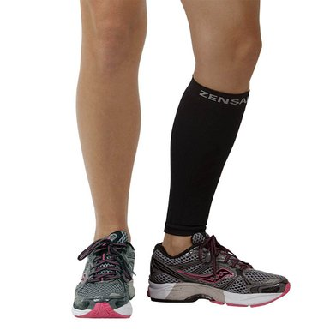
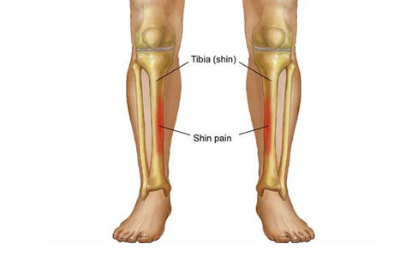

Slide 7
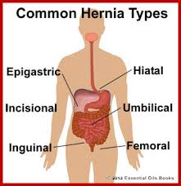
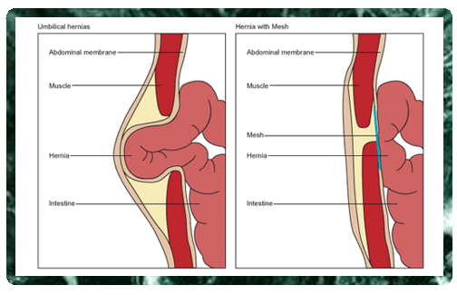
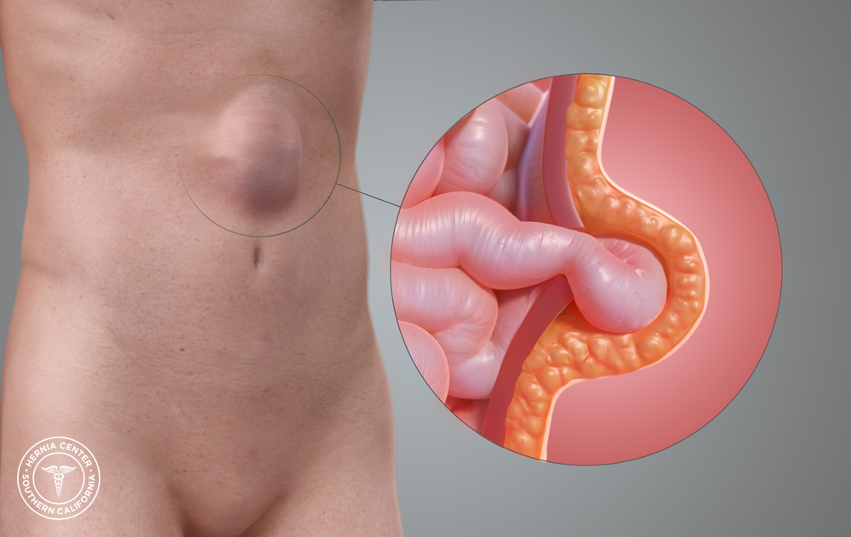
Hernia: a hole or tear in the abdominal wall
Cause: over use
Treatment: surgery

Slide 8
Muscular Dystrophy: a group of diseases that cause progressive weakness and loss of muscle mass. In muscular dystrophy, abnormal genes (mutations) interfere with the production of proteins needed to form healthy muscle.
Cause: inherited
Treatment: genetic preventions

Slide 9
Some people who have muscular dystrophy will eventually lose the ability to walk. Some may have trouble breathing or swallowing. There is no cure for muscular dystrophy. But medications and therapy can help manage symptoms and slow the course of the a group of disorders characterized by muscle weakness and loss of tissue.

Slide 10
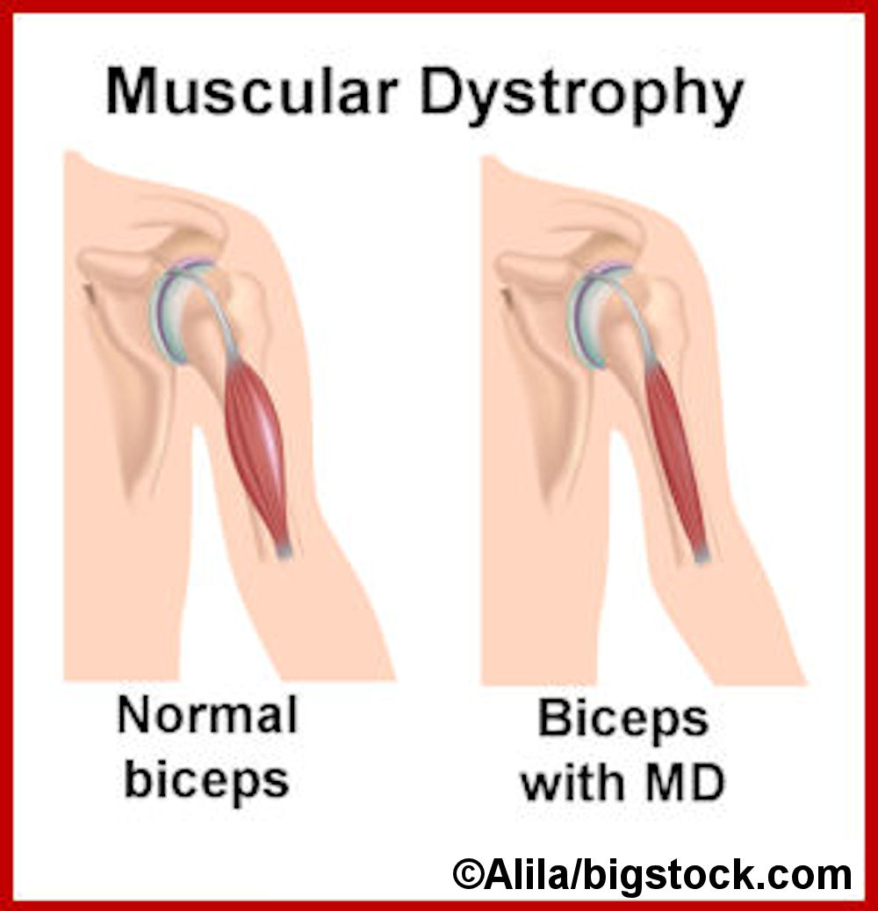

Slide 11
Contusion: region of injured tissue or skin in which blood capillaries have been ruptured; a bruise.
Cause: a direct blow or repeated blows from an outside force on a muscle.
Treatment: R.I.C.E
R = rest: protect the injured area from further harm by stopping play. You may also use a protective device: crutches, sling
I = Immobilize (and Ice): keep area stationary (no movement)
Ice for 20 minutes ( or 10 on and 10 off)
C = compression: lightly wrap injured area in a soft bandage or ace wrap
E = elevate: raise it to a level above the heart

Slide 12
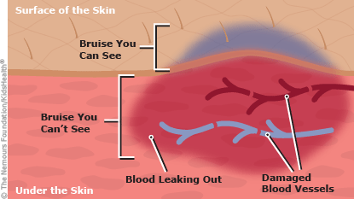
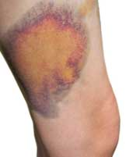
Contusions:

