Slide 1
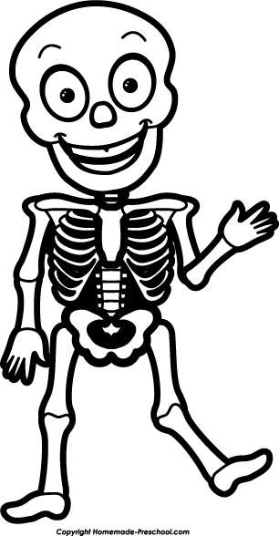
Bone Notes
Bones of the Chest, Pelvis, Arm, Leg

Slide 2
BONES:
Bones of the Chest:
Ribs:12pair
First 7 are ____true______ ribs
_______false_________ Ribs are connected by cartilage (8, 9 and 10)
_____floating_____ Ribs are not attached to the sternum (11, 12)
Bones of the Pectoral Girdle:
___clavicle___(collarbone0 and ___scapula___(shoulder blade)

Slide 3
Bones:
Bones of the Arm and Hand:
____humerus____(upper arm)_____radius__________(thumb side)
_________ulna___(pinky side)___carpals____(wrist)
______metacarpals___(hand) and_____phalanges____(fingers)
Bones of the Leg and Foot:
______femur_(thigh)___patella___(kneecap)__tibia____(shin),___________fibula_____(side lower leg) ___tarsals____(ankle)___metatarsals___(foot)__phalanges_(toes)

Slide 4
Feet:
Arches:
A. Longitudinal: from heel to toe
B. Traverse: from big toe to little toe
Foot Problems:
A. Corns/calluses:Corns and calluses (hyperkeratosis) are painful areas of thickened skin that appear between the toes and on the soles of the feet.
B. Bunions: A bunion is a painful bony bump that develops on the inside of the foot at the big toe joint. Bunions are often referred to as hallux valgus. Bunions develop slowly. Pressure on the big toe joint causes the big toe to lean toward the second toe.

Slide 5
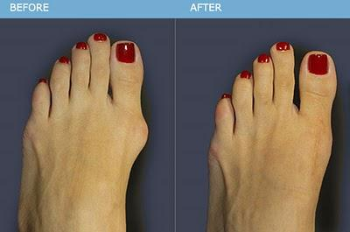
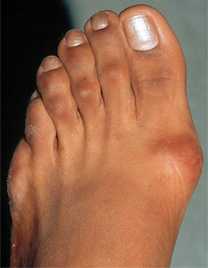
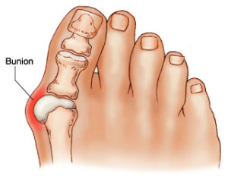
Bunions

Slide 6
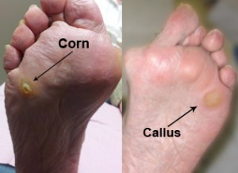
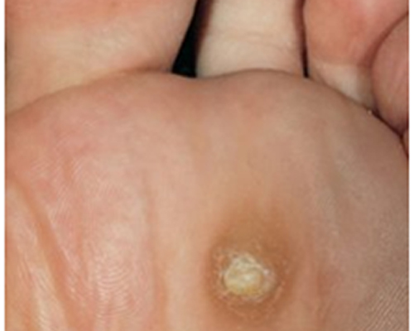
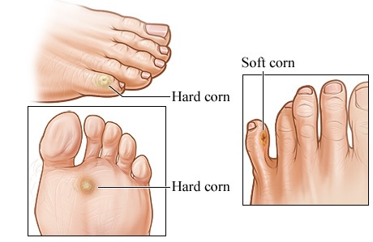
Calluses/Corns

Slide 7
BONES
Bones of the Pelvic Girdle:
Hip bones form in the front to form an arch called the _pelvic_____ ___girdle________. Broad flat bones are called____illium______ and the bone that supports the body in a seated position is called the __ischium_______________.
The bones that arch toward the front and join in the mid line of pelvis are called__________pubis___________.

