Slide 1
Chapter Ten
Fundamentals of General, Organic and Biological Chemistry
6th Edition
Acids and Bases
James E. Mayhugh
Copyright © 2010 Pearson Education, Inc.

Slide 2
10.1 Acids and Bases in Aqueous Solution
An acid is a covalent compound that produces hydrogen ions, H⁺, and an anion when dissolved in water.
HCl (+water) → H⁺_{(aq)} + Cl⁻_{(aq)}
The H⁺ ion is always “picked up” by something else… often water unless there is a base around to “snag” it.

Slide 3
10.1 Acids and Bases in Aqueous Solution
Hydronium ion: H₃O⁺ ion formed when an acid reacts with water.
IT is the “culprit” actually responsible for making a solution “acidic”

Slide 4
10.1 Acids and Bases in Aqueous Solution
Hydroxide ions, OH⁻, are the “culprits” responsible for making solutions basic (or “alkaline”).
A base is a substance that, one way or another, increases the concentration of hydroxide ions, OH⁻, in solution.

Slide 5
There are two ways for this to happen:
An ionic compound containing hydroxide dissolves… thus releasing hydroxide into the solution:
NaOH_{(s)} (+ water) → Na⁺_{(aq)} + OH⁻_{(aq)}
Or a covalent compound removes an H⁺ from water, leaving an OH⁻ behind.

Slide 6
10.2 Some Common Acids – Formulas and Names Must be MEMORIZED
Sulfuric acid, H₂SO₄
Hydrochloric acid, HCl
Phosphoric acid, H₃PO₄
Carbonic acid, H₂CO₃
Nitric acid, HNO₃
Acetic acid, HCH₃CO₂

Slide 7
Acetic Acid Formulas
LOTS of ways that you will see acetic acid’s formula:
HCH₃CO₂
HC₂H₃O₂
CH₃CO₂H
C₂H₃O₂H
HCH₃COO
HC₂H₃OO
C₂H₃OOH

Slide 8
10.3 Some Common Bases - MEMORIZE
All ionic hydroxides: NaOH, Ca(OH)₂, etc.
Ammonia, NH₃

Slide 9
10.3 Acid Base Reactions
In acid / base REACTIONS:
Acids donate an H+ ion to the base.
Bases will accept an H+ ion from the acid.
(Your book calls the above the “Bronsted-Lowery” definitions of acids and bases)

Slide 10
HNO₂ + H₂O  NO₂⁻ + H₃O⁺
Look to see what each substance DOES to turn into its product:

Slide 11
HNO₂ + H₂O  NO₂⁻ + H₃O⁺
Look to see what each substance DOES to turn into its product:
HNO₂ : Loses an H+ so it’s acting as an acid
acid

Slide 12
HNO₂ + H₂O  NO₂⁻ + H₃O⁺
Look to see what each substance DOES to turn into its product:
HNO₂ : Loses an H+ so it’s acting as an acid
H₂O: Takes and H+ so it’s acting as a base
acid
base

Slide 13
HNO₂ + H₂O  NO₂⁻ + H₃O⁺
Look to see what each substance DOES to turn into its product:
HNO₂ : Loses an H+ so it’s acting as an acid
H₂O: Takes and H+ so it’s acting as a base
NO₂⁻ : (on the return trip) Takes an H+… base
acid
base
base

Slide 14
HNO₂ + H₂O  NO₂⁻ + H₃O⁺
Look to see what each substance DOES to turn into its product:
HNO₂ : Loses an H+ so it’s acting as an acid
H₂O: Takes and H+ so it’s acting as a base
NO₂⁻ : (on the return trip) Takes an H+… base
H₃O⁺: (on the return trip) Loses an H+ … acid
acid
base
base
acid

Slide 15
HNO₂ + H₂O  NO₂⁻ + H₃O⁺
acid base base acid
Conjugate base: The substance formed by loss of H⁺ from an acid.
So NO₂⁻ is the conjugate base of HNO₂ and H₂O is the conjugate base of H₃O⁺
Conjugate acid: The substance formed by addition of H⁺ to a base.
What is the conjugate acid of H₂O?
What is the conjugate acid of NO₂⁻?

Slide 16
What is the…
Conjugate acid of HPO₄²⁻ ?
H₂PO₄⁻
Conjugate base of HCO₃⁻ ?
CO₃²⁻

Slide 17
Conjugate acid–base pair: Two substances whose formulas only differ by exactly 1 H⁺ ion
NH₃ + H₂O  NH₄⁺ + OH⁻
What are the conjugate acid/base pairs?
NH₃ / NH₄⁺ and H₂O / OH-

Slide 18
10.5 Acid and Base Strength
“Strong” Acids - acids that are strong electrolytes, which means that ...
…100% of the molecules “dissociate” (break up into ions) when dissolved in water
HCl is a strong acid: HCl → H⁺ + Cl⁻
100%

Slide 19
10.5 Acid and Base Strength
There are only 6 strong acids… you will need to memorize 3 of them:
HCl H₂SO₄ HNO₃

Slide 20
10.5 Acid and Base Strength
“Weak” Acids - acids that are weak electrolytes.
When it reaches equilibrium, only about 1-5% of the molecules dissociate (break up into ions) when dissolved in water
HNO₂ is a weak acid: HNO₂  H⁺ + NO₂⁻
~98% ~2%
remain intact
Most acids are weak

Slide 21
10.5 Ka of Weak Acids
HNO₂ (aq) + H₂O (l)  H₃O⁺ (aq) + NO₂⁻ (aq)

Slide 22
10.5 Acid and Base Strength
Strong Base: Any ionic compound containing the hydroxide (OH-) ion
100% of ionic compounds break into ions when they dissolve
NaOH → Na⁺ + OH⁻ (100%)
Ca(OH)₂ → Ca²⁺ + 2 OH⁻ (100%)

Slide 23
10.5 Acid and Base Strength
Weak base: Any substance acting as a base that does NOT contain hydroxide.
NH₃ + H₂O  NH₄⁺ + OH⁻
~ 0.5%

Slide 24
10.7 H₃O⁺ and OH⁻ in Pure Water
“Auto-ionization” of water
H₂O_{(l)} + H₂O_{(l)}  H₃O⁺_{(aq)} + OH⁻ _{(aq)}
The equilibrium equation for water, K_{w}, is:
K_{w} = [H₃O⁺][OH⁻]
K_{w} = 1.00 x 10⁻¹⁴ at 25ºC.
So in pH neutral water:
[H₃O⁺]=[OH⁻]=1.00x10⁻⁷M each

Slide 25
10.7 H₃O⁺ and OH⁻ in Pure Water
Acidic solution:
[H₃O⁺]> 10⁻⁷ M and [OH⁻]< 10⁻⁷ M
Basic solution:
[H₃O⁺]< 10⁻⁷ M and [OH⁻]> 10⁻⁷ M

Slide 26
10.7 Using Kw
If a solution’s [OH⁻] = 1.5x10⁻⁹ M
(a) Is the solution acidic or basic?
(b) What is the [H₃O⁺] ?
K_{w} = [H₃O⁺][OH⁻] = 1.00 x 10⁻¹⁴
In neutral solutions: [H₃O⁺]=[OH⁻]=1.00x10⁻⁷M

Slide 27
10.8 Measuring Acidity in Aqueous Solution: pH
pH is just a variation of the [H₃O⁺ ] of a solution
pH = -log [H₃O⁺ ]
[H₃O⁺ ] = 10^{-pH}
(Round all pH values to 2 decimal places, regardless of normal sig fig rules)

Slide 28
10.8 Measuring Acidity in Aqueous Solution: pH
pH = -log [H₃O⁺ ]
Acidic solution: pH < 7
Neutral solution: pH = 7
Basic solution: pH > 7

Slide 29
10.8 Calculating pH of Strong Acids and Bases
The [H₃O⁺ ] of a strong acid is equal to the molarity of the original acid solution.
What is the pH of a 0.35 M HNO₃ solution?
[H₃O⁺ ] = 0.35 M
(but ONLY because HNO₃ is a “strong” acid)
So pH = - log 0.35
= 0.46

Slide 30
10.8 Calculating pH of Strong Acids and Bases
pH = -log [H₃O⁺ ] [H₃O⁺ ][OH-] = 1.00x10⁻¹⁴
The [OH⁻ ] of a strong base is the molarity of the strong base TIMES the # of OH- ions in the compound.
Then use Kw to calculate [H₃O⁺ ]
Then calculate pH from the [H₃O⁺ ]

Slide 31
10.8 Calculating pH of Strong Acids and Bases
pH = -log [H₃O⁺ ] [H₃O⁺ ][OH-] = 1.00x10⁻¹⁴
What is the pH of a 0.800 M Mg(OH)₂ solution?
[OH-] = 0.800 x 2 = 1.60 M
[H₃O⁺ ] = 1.00 x 10⁻¹⁴ / 1.60
= 6.30x10⁻¹⁵
pH = - log (6.30x10⁻¹⁵) = 14.2

Slide 32
10.8 Calculating pH of WEAK Acids and Bases
You will be given the molarity of acid or base …
AND the percent of it that turns into H₃O⁺ or OH-

Slide 33
10.8 Calculating pH of WEAK Acids and Bases
What is the pH of a 0.25M solution of the weak base ammonia (NH₃) if 0.50% of it reacts to form OH-?
[OH-] = 0.25 x 0.0050 = 0.0013 M OH-
Dividing 0.0013 into Kw like previously…
we find that [H₃O⁺ ] = 7.7x10⁻¹² M
So pH = - log (7.7x10⁻¹²) = 11.1

Slide 34
10.11 Buffer Solutions
Buffer: A combination of substances that act together to resist changes in pH
a mixture of a weak acid and its conjugate base.
Which of the following combinations would make a buffer solution?
1. HCl and NaCl
2. HNO₂ and NaNO₂
3. H₂CO₃ and Na₂CO₃
4. HPO₄²⁻ and Na₃PO₄

Slide 35
10.11 Buffer Solutions
1. HCl and Cl⁻
2. HNO₂ and NO₂⁻
3. H₂CO₃ and CO₃²⁻
4. HPO₄²⁻ and PO₄³⁻
HCl is a strong acid, not weak
CO₃²⁻ is not the conjugate base of H₂CO₃, HCO₃⁻ is.

Slide 36
10.11 pH of a Buffer Equation
pH = pKa + log [conj. Base]
[ acid ]
Where pKa = - log Ka_{buffer acid}

Slide 37
10.11 pH of a Buffer Equation
pH = pKa + log [conj. Base]
[ acid ]
(your book calls this the Henderson-Hasselbach equation)
(you do NOT need to memorize this equation… it will be given)

Slide 38
10.11 pH of Buffer Solutions
pH = pKa + log [conj. Base]
[ acid ]
What is the pH of a buffer that consists of
0.25 M H₂CO₃ and 0.15 M HCO₃⁻ ? The pKa of H₂CO₃ is 6.4

Slide 39
10.11 pH of Buffer Solutions
pH = pKa + log [conj. Base]
[ acid ]
What is the pH of a buffer that consists of
0.25 M H₂CO₃ and 0.15 M HCO₃⁻ ? The pKa of H₂CO₃ is 6.4
pH = 6.4 + log 0.15 M = 6.4 + log(0.60) = 6.2
0.25 M

Slide 40
10.11 Choosing an Appropriate Buffer mixture
pH = 6.4 + log 0.15 M = 6.2
0.25 M
Notice that the pH of the buffer is close to the pKa of the acid… that should ALWAYS be the case!
So… choose an acid whose pKa is close to the goal pH
Then… mix it with a compound that contains its conjugate base

Slide 41
10.11 Choosing an Appropriate Buffer mixture
Which acid would you choose for the weak acid part of a buffer solution with a pH of 3.5?
a) HNO₂ (pKa = 3.39)
b) H₂CO₃ (pKa = 6.35)
c) HF (pKa = 3.14)
What would you mix with that acid to make the buffer solution?
a compound containing NO₂⁻ (like NaNO₂)

Slide 42
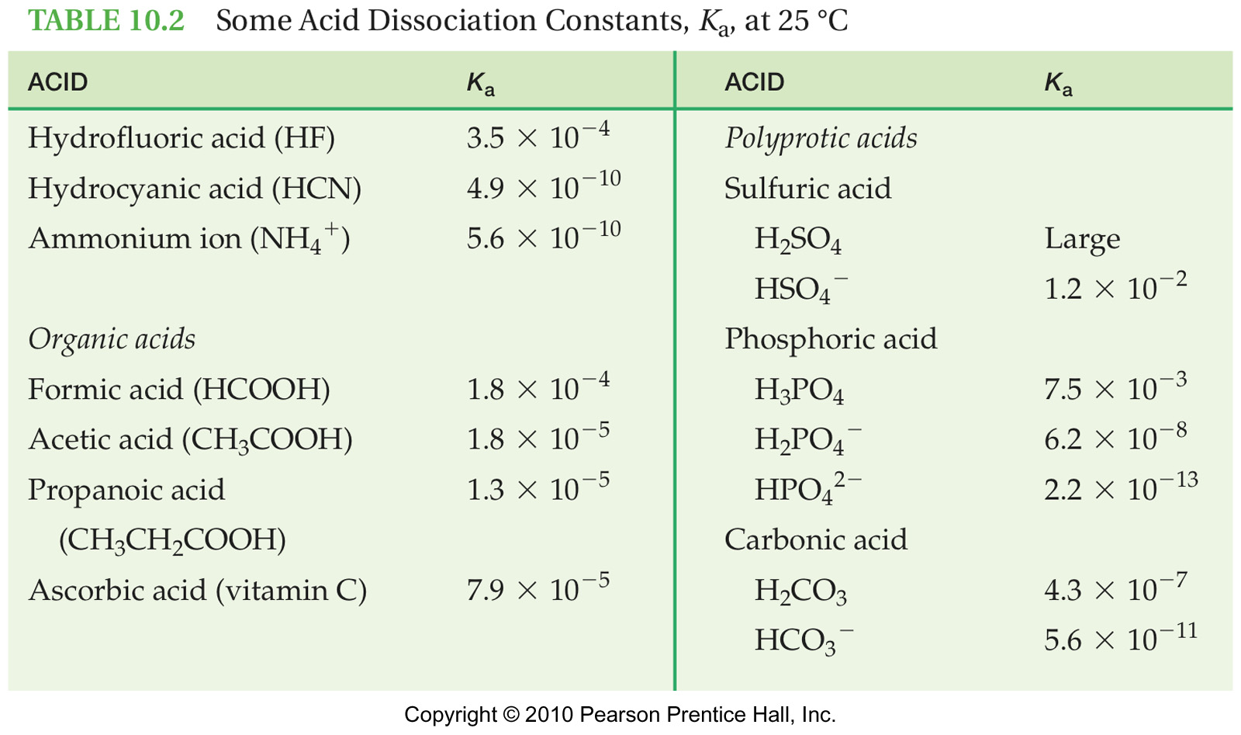
10.11 Choosing an Appropriate Buffer mixture
Your book only lists Ka values…
To help find pKa values for HW problems, I would calculate the pKa of each of these and write them in your book.

Slide 43
10.11 Choosing an Appropriate Buffer mixture
To do this:
pKa = - log Ka
What is the pKa of HF, whose Ka = 3.5 x 10⁻⁴ ?

Slide 44
10.11 How Buffers Work
How does the HF / F⁻ buffer solution keep the pH around 3.2?
If a base is added to the buffer solution:
OH- + HF → H₂O + F⁻
the base has been neutralized so pH resists change!

Slide 45
10.11 How Buffers Work
How does the HF / F⁻ buffer solution keep the pH around 3.2?
If an acid is added to the buffer solution:
H₃O⁺ + F⁻ → H₂O + HF
the acid has been neutralized so pH resists change!

Slide 46
10.11 How Buffers Work
HF / F⁻
And each reaction generates more of the other buffer component!
H₃O⁺ + F⁻ → H₂O + HF
OH- + HF → H₂O + F⁻

Slide 47
10. 12 Buffers in the Body
The pH of body fluids is maintained by three major buffer systems.
The H₂CO₃ / HCO₃⁻ system is the principal buffer in blood
It keeps the pH of blood at ~ 7.4
(H₂CO₃ is made by CO₂ mixing with H₂O)

Slide 48
Conjugate ratios in a buffer
If the pKa of H₂CO₃ = 6.37, what is the ratio of HCO₃⁻ to H₂CO₃ in blood if the pH of blood is 7.40?

Slide 49
10.14 Acid / Strong Base Neutralization Reactions
All acid/base reaction examples thus far this chapter have been net ionic equations.
But sometimes full molecular chemical equations are more useful
So a review is in order…

Slide 50
10.14 Acid / Strong Base Neutralization Reactions
Acid + Strong Base → water + aqueous salt
HA_{(aq)} + MOH_{(aq)}→H₂O_{(l)} +MA_{(aq)}
“salt” is another term for an ionic compound
If the water is evaporated away, you could recover the ionic compound that was produced

Slide 51
10.14 Acid / Strong Base Neutralization Reactions
Predicting products of neutralization rxns:
They are double replacement reactions… studied in chapter 6…
“Swap partners”, re-check charges, balance

Slide 52
10.14 Acid / Strong Base Neutralization Reactions
Write the balanced equation for the reaction between:
Nitric acid and calcium hydroxide
Acetic acid and sodium hydroxide

Slide 53
10.15 Titration
An experimental technique used to determine the molarity of an acid or base solution.
“Titrating” is the process of carefully adding a base to an acid until the acid is neutralized (or vice versa).
The base is dispensed from a special device called a buret

Slide 54
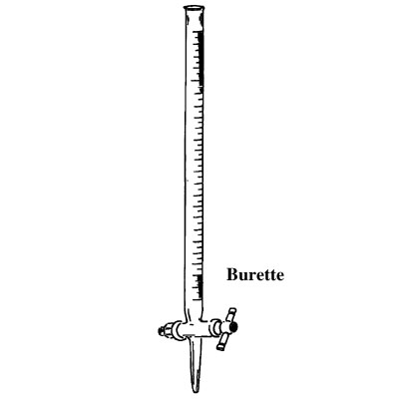
10.15 Titration

Slide 55
A measured volume of the acid solution is placed in the flask along with an indicator.

Slide 56
A measured volume of the acid solution is placed in the flask along with an indicator.
The base of known concentration is then added from a buret until the color change of the indicator shows that neutralization is complete.

Slide 57
10.15 Titration Calculations
If your goal is the M_{acid}, then
Molarity_{acid} = moles_{acid}
Liters_{acid}
Volume of acid will be known
Determine the moles of acid in the sample by stoichiometry based on how many moles of base it took to neutralize it.

Slide 58
10.15 Titration Calculations
Example 1:
25.0 mL of H₂CO₃ are put into a flask and titrated with 0.150M NaOH. If it requires 18.2 mL of NaOH to neutralize the acid, what was the molarity of the acid?

Slide 59
10.15 Titration Calculations
Example: 25.0 mL of H₂CO₃ are put into a flask and titrated with 0.150M NaOH. If it requires 18.2 mL of NaOH to neutralize the acid, what is the molarity of the acid?
1st step?
Balanced equation
H₂CO₃ + 2 NaOH → 2 HOH + Na₂CO₃

Slide 60
2. Since molarity of H₂CO₃ is the unknown, use stoichiometry to find moles of this acid needed for the neutralization.
(Which will then be divided by the liters of H₂CO₃ solution to find molarity)

Slide 61
Example: 25.0 mL of H₂CO₃ are put into a flask and titrated with 0.150M NaOH. If it requires 18.2 mL of NaOH to neutralize the acid, what is the molarity of the acid?
H₂CO₃ + 2 NaOH → 2 HOH + Na₂CO₃
0.0182 L NaOH x 0.150 mol NaOH x 1mol H₂CO₃ =
1 L 2 mol NaOH
0.00137 mol H₂CO₃

Slide 62
10.15 Titration Calculations
Example: 25.0 mL of H₂CO₃ are put into a flask and titrated with 0.150M NaOH. If it requires 18.3 mL of NaOH to neutralize the acid, what is the molarity of the acid?
moles acid = 0.00137mol H₂CO₃
3. Calculate M_{acid}:
M_{acid} = moles acid
Liters_{acid}
= 0.00137 mol = 0.0548 M
0.0250 L

Slide 63
10.15 Titration Calculations
Example #2:
0.350 g of KHP (HKC₈H₄O₄ … MM=204.1 g/mol) is dissolved in 250. mL of water and titrated to the endpoint with NaOH. The buret readings dropped from 0.13 mL to 14.44 mL. What is the molarity of the base?
HKC₈H₄O₄ + NaOH → HOH + NaKC₈H₄O₄
(note the 1:1 ratio of acid to base)

Slide 64
10.15 Titration Calculations
Example #2:
0.350 g of KHP (HKC₈H₄O₄ … MM=204.1 g/mol) is dissolved in 250. mL of water and titrated to the endpoint with NaOH. The buret readings dropped from 0.13 mL to 14.44 mL. What is the molarity of the base?

Slide 65
10.15 Titration Calculations
Example #3:
How many mL of 0.520M NaOH would be required to neutralize 100.mL of a 0.150M sulfuric acid solution?

Slide 66
End of Chapter 10

