Slide 1
Chapter Eleven
Fundamentals of General, Organic and Biological Chemistry
7th Edition
Nuclear Reactions
James E Mayhugh
Copyright © 2010 Pearson Education, Inc.

Slide 2
11.1 Changes in the Nucleus
Nuclear reactions
Any reaction that causes the number of protons and/or neutrons in the nucleus of an atom to change
(Chemical reactions involve the gain, loss or sharing of ELECTRONS)

Slide 3
2.2 Review: Protons and Neutrons
Atomic Number (Z): The number of protons in each atom of an element.
It’s THE characteristic that defines which element it is.
Atoms are neutral …# of p⁺ = # of e⁻ # of neutrons is usually NOT equal to protons and electrons!!
Mass Number (A): The number of protons plus neutrons in an atom.
AX
Z

Slide 4
2.3 Isotopes
Isotopes: Atoms with identical atomic numbers (Z) but different mass numbers (A) are called isotopes.
# of protons are the same, but # of neutrons are different
Isotopes of a given element have identical CHEMICAL properties, but different NUCLEAR properties.

Slide 5
11.3 Nuclear Stability
A stable nucleus does NOT release radiation
An isotope of an atom with an unstable nucleus is said to be radioactive
Also known as a “radioisotope”
An unstable nucleus will at some point emit a particle to try to become more stable

Slide 6
11.4 Radioactive Decay
This particle emission is called radioactive decay
the number of protons changes, so the ID of the element changes.
Notes:
6

Slide 7
11.4 Radioactive Decay
A stream of the emitted particles is called nuclear radiation
Typical types:
Alpha radiation α
Beta radiation β
Positron radiation
Notes:
6

Slide 8
What Makes a Nucleus Unstable (Radioactive)?
ANY nucleus with 84 or more protons is unstable
Any atom with an “unfavorable” neutron to proton ratio is unstable.
Favorable ratios are depicted by …
(GET READY FOR IT!)
Notes:
6

Slide 9
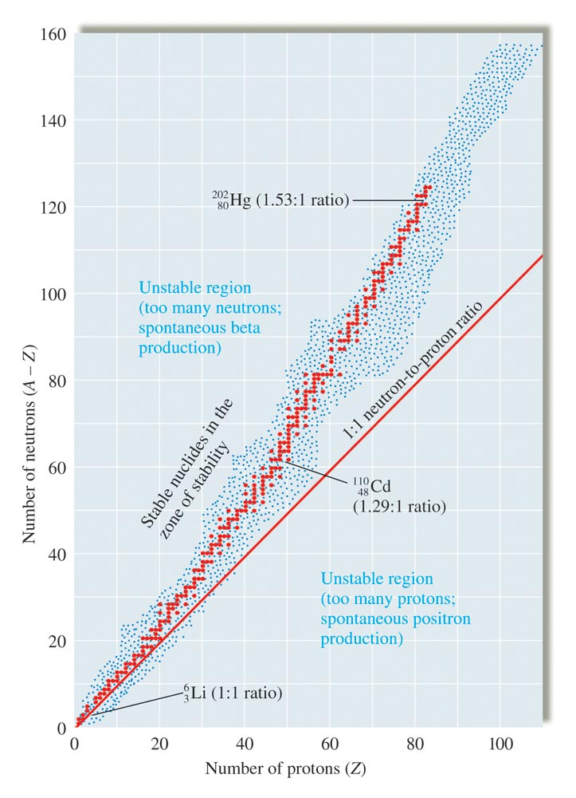
The Belt of Stability OF SCIENCE!!!

Slide 11
Any (p+ , no) ordered pair in the “red” zone IS stable.

Slide 12
Any (p+ , no) ordered pair OUTSIDE of the “Belt of Stability of SCIENCE” is NOT stable.

Slide 13
Any (p+ , no) ordered pair in the “red” zone IS stable.
Any (p+ , no) ordered pair OUTSIDE of the “Belt of Stability of SCIENCE” is NOT stable.

Slide 14
Types of Radioactive Decay
Alpha particle emission (α):
a.k.a: alpha decay
Alpha particles have low penetrating power (paper can stop them)
A cluster of 2 protons and 2 neutrons
Notes:
1

Slide 15
Types of Radioactive Decay
Alpha particle emission (α):
a.k.a: alpha decay
Alpha particles have low penetrating power (paper can stop them)
A cluster of 2 protons and 2 neutrons
Symbol for alpha particles in nuclear equations:
Notes:
1

Slide 16
Types of Radioactive Decay
“Purpose” of alpha emission:
to reduce the number of protons in the nucleus that has over 83 protons.
Notes:
1

Slide 17
Types of Radioactive Decay
Alpha emission (α):
Example: → +
238U
92
Notes:
1

Slide 18
Types of Radioactive Decay
Alpha emission (α):
Example: → +
The U-238 has “decayed” into Th-234
When any atom changes into another, it’s called a transmutation
238U
92
4He
2
234Th
90
Notes:
1

Slide 19
Types of Radioactive Decay
Beta emission (β):
Medium penetrating power (100x alpha particles)… can go through skin
They are identical to electrons
Beta particles are produced when a neutron breaks down into a proton and an electron n⁰ → p⁺ + e⁻
The electron (beta particle) is ejected, the proton stays behind
Notes:
1

Slide 20
Types of Radioactive Decay
Beta emission (β):
Medium penetrating power (100x alpha particles)… can go through skin
They are identical to electrons
Beta particles are produced when a neutron breaks down into a proton and an electron n⁰ → p⁺ + e⁻
The electron (beta particle) is ejected, the proton stays behind
Nuclear equation symbol:
Notes:
1

Slide 21
Types of Radioactive Decay
Purpose : to decrease the nº to p⁺ ratio of a nucleus that was “above” the
BELT OF STABILITY OF SCIENCE!
18.1
Notes:
1

Slide 22
Types of Radioactive Decay
Beta emission (β):
99 Zr → ₋₁0 e + ₄₁99 Nb
40
18.1
Notes:
1

Slide 23
Types of Radioactive Decay
Positron decay:
A positron is a particle of antimatter
Same mass as an electron, but it has a positive charge
18.1
Notes:
2

Slide 24
Types of Radioactive Decay
Positron decay:
A positron is a particle of antimatter
Same mass as an electron, but it has a positive charge
Formed when a proton decomposes
p+ → n0 +
0e+
1
18.1
Notes:
2

Slide 25
Types of Radioactive Decay
Purpose is to increase the no to p+ ratio for a nuclide that is BELOW the…
BELT OF
STABILITY
OF SCIENCE!
18.1
Notes:
2

Slide 26
Types of Radioactive Decay
Positron production: sodium-22
18.1
Notes:
2

Slide 27
Radioactive Decay Summary
Alpha decay (α) symbol: ₂⁴He
Done by atoms with >83 protons
Main purpose is to reduce the number of protons
Beta decay (β) symbol: ₋₁⁰e
Done by atoms with a nº:p⁺ ratio that is too high
Positron decay symbol: ₊₁⁰e
Done by atoms with a nº:p⁺ ratio that is too low
Gamma radiation(γ) symbol: ₀⁰γ
(next slide…)

Slide 28
Types of Radioactive Decay
Gamma ray production (γ):
NOT a particle… it’s pure energy
Will often accompany alpha and beta radiation
Very high penetrating power
Purpose: to lower the overall energy
Notes:
2

Slide 29
11.10 Artificial Transmutation Reactions
It’s how “man-made” elements are created
a.k.a. Nuclear bombardment reactions
Two particles are slammed into each other at high speeds to create a larger particle

Slide 30
11.10 Artificial Transmutation Reactions
It’s how “man-made” elements are created
a.k.a. Nuclear bombardment reactions
Two particles are slammed into each other at high speeds to create a larger particle
²⁰⁹Bi + ⁵⁸Fe → + 2 ¹n
⁸³ 26 0
265Mt
109

Slide 31
11.5 Radioactive Half-Life
Rates of nuclear decay are measured in terms of half-life …
defined as the amount of time required for one-half of the radioactive isotope to decay.
For example: the half-life of Iodine-131 is 8 days.

Slide 33
11.5 Radioactive Half-Life
Radioactive decay occurs at an exponentially decreasing rate.
In Algebra II/Trig, you learn how to predict the final amount of an exponential decay of a system: A = A_{o}e^{-kt}
This equation can be simplified if A = ½ A_{o}

Slide 34
11.5 Radioactive Half-Life Equation
final amount = (0.5)^{(total time / half-life time)}
initial amount

Slide 35
11.5 Radioactive Half-Life Equation
final amount = (0.5)^{(total time / half-life time)}
initial amount
BUT… if either “total time” or “half-life time” is the unknown, we need to take the log₁₀ of both sides to get this equation:

Slide 36
11.5 Radioactive Half-Life
log final amount = total time · log(0.5)
initial amount half-life time
Then solve the equation (correctly!!!) for the unknown

Slide 37
Example 1: 100. mg of Iodine-131 (half-life = 8.0 days) is allowed to sit for 20. days. How many mg of I-131 remain?
x mg = (0.5)^{(20/8)}
100 mg
18 mg

Slide 38
Example 2: The half-life of a radioactive element is 1.35 years. How many years will it take a 125g sample of that isotope to decay to 30.0g?
final amount = (0.5)^{(total time / half-life time)}
initial amount
log final amount = total time · log(0.5)
initial amount half-life time

Slide 39
Example 2: The half-life of a radioactive element is 1.35 years. How many years will it take a 125g sample of that isotope to decay to 30.0g?
log final amount = total time · log(0.5)
initial amount half-life time

Slide 40
Example 2: The half-life of a radioactive element is 1.35 years. How many years will it take a 125g sample of that isotope to decay to 30.0g?
log final amount = total time · log(0.5)
initial amount half-life time
log (30.0 g) = x years · log (0.5)
(125 g) 1.35 yrs
2.78 years

Slide 41
Example 3 : 150. g of a radioactive element sits for 12.0 hours. At that time, 24.2 g remains of the element. What is the half-life of this element?

Slide 42
Example 3 : 150. g of a radioactive element sits for 12.0 hours. At that time, 24.2 g remains of the element. What is the half-life of this element?
log (0.161) = . 12 hr · log (0.5)
half-life
4.55 hr

Slide 43
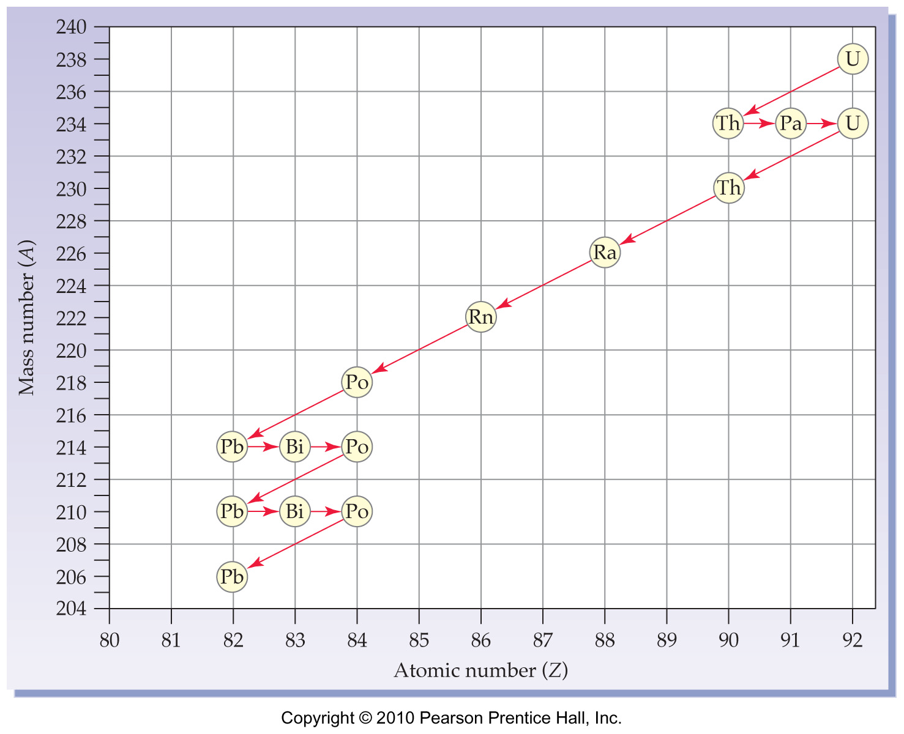
11.6 Radioactive Decay Series

Slide 44
11.11 Nuclear Fission, Nuclear Power Plants and Nuclear Fusion
Nuclear Fission
1. In a bombardment reaction “gone wrong”, _______________ was bombarded with neutrons. But instead of a larger atom being formed, a smaller atom was detected. Austrian physicist Lise Meitner was able to figure out what happened… instead of the neutrons being absorbed into the uranium nucleus, it _____________
the uranium nucleus… a nuclear __________________ reaction.
Uranium
split
fission

Slide 45
2. A nuclear fission reaction does not happen by itself… it requires a neutron to initiate it.
3. The products of the reaction are __________ smaller atoms and several ejected ____________________.
4. There are very few isotopes that will split when hit with a neutron. The ONLY naturally occurring isotope that will fission is _________-_____. Uranium-238, the most common isotope of uranium (by FAR) will NOT fission (split).
two
neutrons
Uranium 235

Slide 46
5. Another isotope that is commonly used in nuclear fission reactions is plutonium-239, but this must be synthetically.
Here is one of the possible outcomes of a nuclear fission reaction of 235U.
235U + 1n → 140Ba + 93Kr + 3 1n + ENERGY!

Slide 47
5. Another isotope that is commonly used in nuclear fission reactions is plutonium-239, but this must be synthetically.
Here is one of the possible outcomes of a nuclear fission reaction of 235U.
235U + 1n → 140Ba + 93Kr + 3 1n + ENERGY!
Intensely radioactive (very short half-lives)… THIS is the “nuclear waste” that is so dangerous.

Slide 48
Chain reactions
7. Did you notice that the __________________ particles in the above fission reactions are the same as the original projectiles? They are both neutrons. This means that the ejected neutrons can themselves cause further _________________ (fission) of atoms when they hit the nucleus of a uranium-235 atom.
ejected
splitting

Slide 49
If this occurs to a great enough extent, this will cause a _______ _______ to occur. In other words, we just have to supply the first few neutrons, then the ejected neutrons do the rest of the job by themselves! This is what makes nuclear fission so powerful (and potentially deadly!).
chain reaction

Slide 50
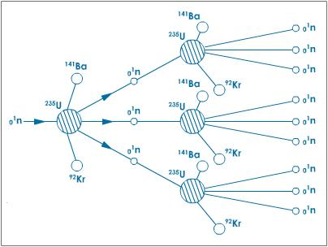
Chain Reaction:

Slide 51
9. But to make sure that a chain reaction occurs, you have to make sure that there is enough uranium-235 concentrated in a small area. If it is too spread out, the ejected neutrons will miss their targets and escape without having caused more fissions. The minimum amount of fissionable material needed to sustain a chain reaction is called the ______ _____.
critical mass

Slide 52
Nuclear Power Plants 10. Basic purpose and function of plant: The first step is to use the ___________ generated from nuclear fission reactions to _________ water. The ___________ is then forced into narrow pipes, thus greatly increasing the _____________ of the steam. This high- pressure steam is then “shot” through huge _______________. The turbine blades spin like when you blow through a _________________. The spinning turbine blades are connected to an electrical _______________, thus creating electricity.
heat
boil
steam
pressure
turbines
pinwheel
generator

Slide 53
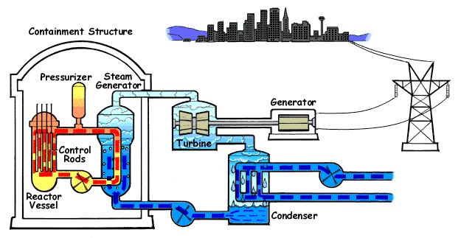
To the steam tower

Slide 54
11. The fuel:
The fuel for a nuclear reactor is a mix of about ______ uranium-235 (the isotope that fissions (splits)) and ______ uranium-238 (the isotope that doesn’t fission).
3%
97%

Slide 55
11. The fuel:
(The percentage of uranium-235 in an atomic bomb is close to 100%... that’s why a nuclear power plant can’t explode like an atomic bomb!)

Slide 56
11. The fuel:
The natural abundance of uranium is about 0.7% U-235 and 99.3% U-238. To get the percentage up to 3% (for reactors) or 100% (for bombs), the uranium has to go through a process called ___________________ to concentrate the U-235.
enrichment

Slide 57
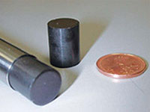
The uranium fuel mixture is in the form of pellets about the size of a ___________ _______.
Each pellet will provide the same amount of heat as burning ____________ of coal or _____________ gallons of gasoline!!!
Tootsie Roll
1 ton
126

Slide 58
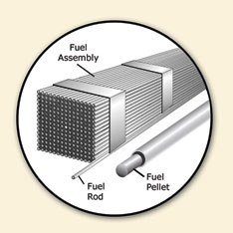
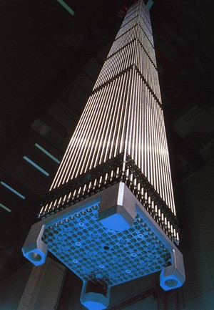
The pellets are arranged in long metal tubes called ________ ________. Many of these fuel rods are bundled together into a fuel rod ____________________.
fuel rods
assembly

Slide 59
There are 3 fuel rod assemblies per reactor, so Limerick Power Plant, with its two reactors, has a total of 6 fuel rod assemblies. (That adds up to about 10 ______________ fuel pellets per power plant!!) Each fuel rod assembly lasts for 3 ________________. (Compared to the tons of coal needed daily for a coal-fired power plant)
million
years

Slide 60
12. Control Rods
Purpose: To _______ _______ the uranium – 235 chain reaction… to control the rate that it reacts and gives off heat.
How?: Contains an element (usually boron) that can absorb _______________. They can be raised and lowered through the gaps between the fuel rods.
Slow down
neutrons

Slide 61
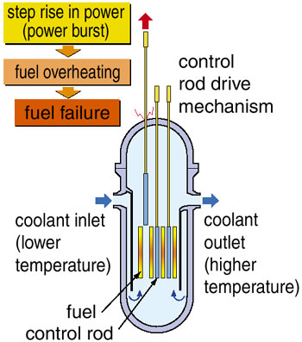
If the chain reaction is proceeding too quickly, the control rods are lowered to absorb some of the neutrons so that fewer of them are able to ____________ more uranium-235 atoms. If the reaction is too slow, the rods are raised up some to allow more of the neutrons to “do their thing”.
split

Slide 62
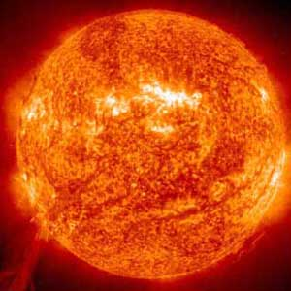
Nuclear Fusion
This is the process by which the sun works: two isotopes of hydrogen fuse together to make one atom of helium, releasing huge amounts of energy in the process.

Slide 63
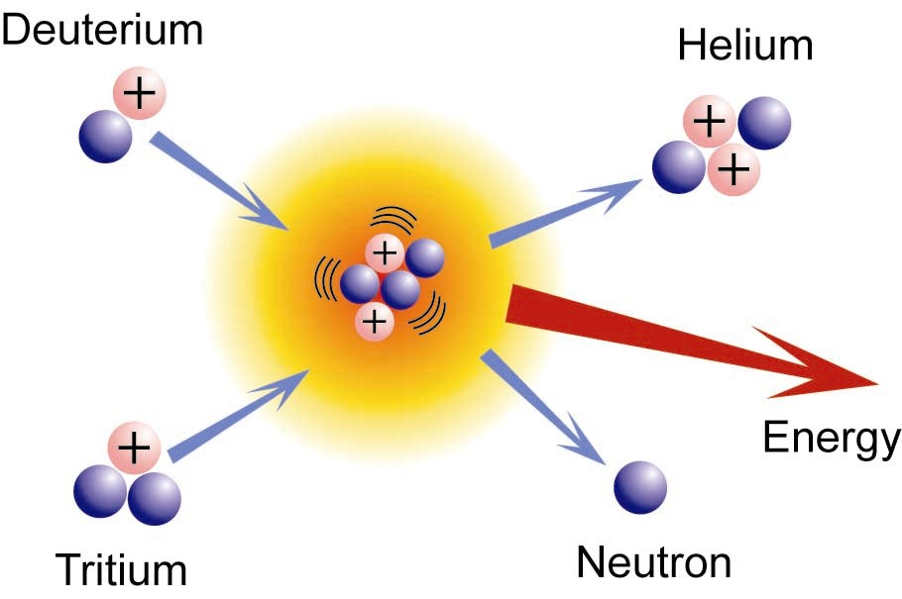
Nuclear Fusion

Slide 64
END OF CHAPTER 11

