Slide 1
Chapter Nine
Fundamentals of General, Organic and Biological Chemistry
6th Edition
Solutions
James E. Mayhugh
Copyright © 2010 Pearson Education, Inc.

Slide 2
9.1 Solutions
Homogeneous mixture: A uniform mixture that has the same composition throughout.
Solution A homogeneous mixture that contains particles the size of a typical ion or small molecule.

Slide 3
9.1 Solutions
The most common solutions we will encounter in this course are aqueous solutions:
The solvent is water
The solute is a solid or a gas

Slide 4
9.2 The Solution Process
“like dissolves like”: Polar solutes will dissolve in polar solvents… nonpolar solutes will dissolve in nonpolar solvents
A “polar vs. nonpolar” review is probably in order, don’t you think?

Slide 5
4.10 Criteria for a Molecule to be Nonpolar
a) there are NO lone pairs on the central atom
AND
b) all the outside atoms are the same.

Slide 6
4.10 Criteria for a Molecule to be Nonpolar
if either “a” or “b” is a “fail”, then the molecule is POLAR… it’s polar bonds did NOT cancel

Slide 10
9.2 The Solution Process
One added “polarity” tip:
All hydrocarbons (C_{x}H_{y}) are non-polar:

Slide 11
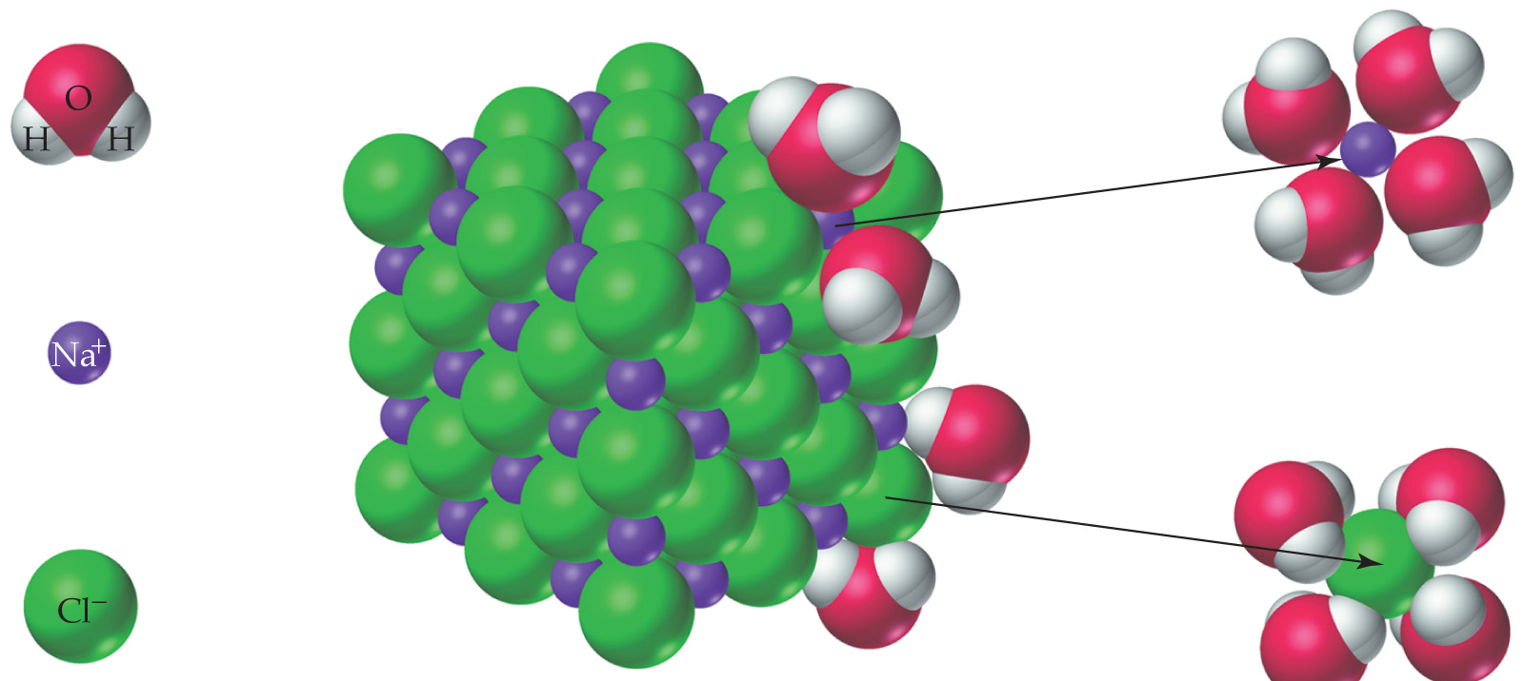
The dissolving process:
δ- end of water attracts Na+ ions and surround them
δ+ end of water attracts Cl- ions and surround them

Slide 12
9.2 The Solution Process
In most cases:
Dissolving is endothermic (unfavorable)
But… dissolving a solid results in increased entropy (favorable)

Slide 13
9.4 Solubility
Terms:
a saturated solution: the maximum amount of solute has dissolved in that amount of water at that temperature.
Any additional solute would settle to the bottom of the container

Slide 14
9.4 Solubility
Terms:
an unsaturated solution: more solute can still be dissolved the solvent
a supersaturated solution: a solution where more solute has been FORCED to be dissolved than normally should be able to.
More on this later.

Slide 15
9.4 Solubility
Terms:
Solubility: The maximum amount of a substance that will dissolve in a given amount of solvent at a given temperature.
Translated: the amount of solute it takes to saturate the solution.

Slide 16
9.5 The Effect of Temperature on Solubility
The effect of temperature is different for every substance.
“Rules of thumb”
Most (but not all) solids are more soluble at higher temperatures than lower temp.
ALL gases are LESS soluble at higher temperatures

Slide 17
SOLIDS

Slide 18
GASES

Slide 19
9.5 Using Solubility Curves
Use the information on the graph to answer various types of questions:

Slide 20
How many grams of KBr can dissolve in 100 mL of water at 40ºC?

Slide 21
How many grams of KBr can dissolve in 100 mL of water at 40ºC? ~73 grams

Slide 22
How many grams of glucose can dissolve in 50 mL of water at 20ºC?

Slide 23
How many grams of glucose can dissolve in 50 mL of water at 20ºC? ~45 grams

Slide 24
If 50 g of CuSO₄ is stirred into 200 mL of water at 60ºC, is the solution saturated or unsaturated?

Slide 25
If 50 g of CuSO₄ is stirred into 200 mL of water at 60ºC, is the solution saturated or unsaturated?

Slide 26
What will happen when 120 g of NaNO₃ are stirred into 100 mL of water at 40ºC?

Slide 27
What will happen when 120 g of NaNO₃ are stirred into 100 mL of water at 40ºC? ~105 g will dissolve, and ~ 15 g will settle to the bottom…SATURATED

Slide 28
Back to Supersaturation:
The only way to supersaturate a solution is to
Put excess solid into a saturated solution
Heat solution to dissolve the excess
Slowly cool solution back to original temp

Slide 29
One of two things will happen during cooling
The excess solid will re-crystallize during cooling …NOT supersaturate
The excess solid will stay dissolved, forming a supersaturated solution!

Slide 30
9.7 Ways of Expressing Solution Concentration
Most “popular” with chemists: Molarity.
The units for molarity:
Officially: moles/L
More commonly: M

Slide 31
9.7 Ways of Expressing Solution Concentration
Other Ways: weight percent or %(w/w)
Mass % = mass of solute x100
(mass of solute + solvent)

Slide 32
Weight/Volume Percent [(w/v)%]

Slide 33
Weight/Volume Percent [(w/v)%]
Volume/Volume Percent [(v/v)%]
(v/v)% = volume of liquid solute x 100
volume of total solution

Slide 34
To calculate molarity, w/v% or v/v%:
Use the formulas given above.
To calculate moles or grams or volume in a given solution, use factor label method… the concentration is your unit converter!!

Slide 35
Your written response to questions asking you to “describe the preparation of…”
“Put ____ grams of (the solute) into an empty container and add water up to the _______mL mark… then mix to dissolve.”
Examples: (done in class)

Slide 36
9.8 Dilution
An easier way to make solutions… dilute a more concentrated “stock solution” down to the desired concentration.
Dilution: Lowering concentration by increasing the total volume by adding additional solvent.

Slide 37
The Dilution Equation
C₁V₁ = C₂V₂
C₁ = concentration of the “stock” solution
V₁ = volume of stock solution to measure out…
Which will then be diluted by adding extra water up to…
V₂ (the final volume after diluting)
C₂ = the diluted (lower) concentration

Slide 38
9.8 Dilution
Example: Describe the preparation of 500.mL of a 6.0% glucose solution from a 20.0% glucose “stock” solution.

Slide 39
9.8 Dilution
Example: How many mL of water must be added to 250. mL of a 2.00 M CuSO₄ solution to dilute it down to 0.450 M ?

Slide 40
9.9 Ions in Solution: Electrolytes
For any substance to be electrically conductive, the substance must contain moving charged particles.
Ions are charged, so solutions containing ions will conduct electricity.

Slide 41
9.9 Ions in Solution: Electrolytes
Electrolyte: A substance that produces ions when dissolved and therefore conducts electricity when dissolved in water.
All ionic compounds (metal + nonmetal)
Acids (HX… like HCl, H₂SO₄)
Even though acids are covalent, they ionize when they dissolve in water:
HCl → H⁺+ Cl⁻

Slide 42
9.9 Ions in Solution: Electrolytes
Nonelectrolyte: A substance that does not produce ions when dissolved in water…
So solutions of these compounds do not conduct electricity
Other than acids, all covalent compounds are nonelectrolytes.

Slide 43
9.11 Colligative Properties of Solutions
The properties of a solvent that change when a solute is dissolved in it are known as colligative properties.
boiling point increases
freezing point decreases
So… adding a solute to water extends water’s LIQUID range in both directions

Slide 44
9.11 Colligative Properties of Solutions
The amount of change of the boiling and freezing points depends ONLY on the total number of particles in solution…
… the identities of those particles is irrelevant.
1 mole of NaCl has the same effect as 2 moles of glucose (C₆H₁₂O₆)

Slide 45
Boiling point elevation of water:

Slide 46
Boiling point elevation of water:
ΔT_{boiling} = 0.51 mol solute # mol of particles
kg solvent 1 mol solute
ºC · kg
mole

Slide 47
Boiling point elevation of water:
ΔT_{boiling} = 0.51 mol solute # mol of particles
kg solvent 1 mol solute
“1” for nonelectrolytes
ºC · kg
mole

Slide 48
Boiling point elevation of water:
ΔT_{boiling} = 0.51 mol solute # mol of particles
kg solvent 1 mol solute
“1” for nonelectrolytes
YOU plug in moles of solute, kg of solvent and # of particles, then solve for the CHANGE in the boiling point.
ºC · kg
mole

Slide 49
Boiling point elevation of water:
ΔT_{boiling} = 0.51 mol solute # mol of particles
kg solvent 1 mol solute
“1” for nonelectrolytes
YOU plug in moles of solute, kg of solvent and # of particles, then solve for the CHANGE in the boiling point.
Then ADD that change to water’s normal boiling point.
ºC · kg
mole

Slide 50
Boiling point elevation of water:
ΔT_{boiling} = 0.51 mol solute # mol of particles
kg solvent 1 mol solute
Example:
What is the boiling point of a solution in which 50.0 g of MgF₂ is dissolved into 100.g of water?
ºC · kg
mole

Slide 51
Freezing point depression of water:
ΔT_{freezing} = 1.86 mol solute # mol of particles
kg solvent 1 mol solute
ºC · kg
mole

Slide 52
Freezing point depression of water:
ΔT_{freezing} = 1.86 mol solute # mol of particles
kg solvent 1 mol solute
You will SUBTRACT the ΔT from water’s normal freezing point.
ºC · kg
mole

Slide 53
Freezing point depression of water:
ΔT_{freezing} = 1.86 mol solute # mol of particles
kg solvent 1 mol solute
Example:
How many grams of NaCl must be added to 500.g of water to drop the freezing point of water to -3.5°C?
ºC · kg
mole

Slide 54
9.12 Osmosis and Osmolarity
Osmosis: The NET diffusion of solvent through a semipermeable membrane separating two solutions of different concentration.

Slide 57
9.12 Osmosis and Osmotic Pressure
Net flow of water is always from region of low solute concentration to region of higher solute concentration

Slide 60
9.12 Osmosis
The greater the concentration DIFFERENCE of the two solutions, the greater the degree of osmosis.

Slide 61
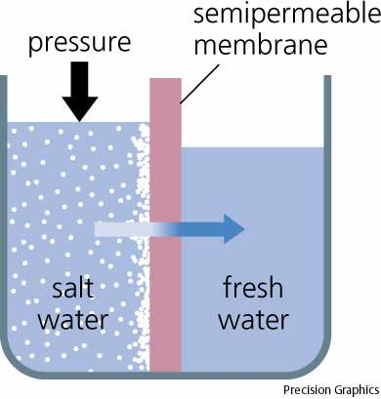
9.12 Turning Sea Water into Fresh Water: Reverse Osmosis
Using External Pressure to Reverse the Process.

Slide 62
Osmolarity (osmol): The concentration of all dissolved particles in a solution.
Osmolarity = molarity x #particles

Slide 63
Isotonic: Solution in bloodstream has the same osmolarity as that of the red blood cells.

Slide 64
Isotonic: Solution in bloodstream has the same osmolarity as that of the red blood cells.
Red blood cells are of normal size.

Slide 65
Hypotonic: Bloodstream has an osmolarity less than the red blood cells.

Slide 66
Hypotonic: Bloodstream has an osmolarity less than the red blood cells.
Resulting in red blood cells that swell up and could burst.

Slide 67
Hypertonic Bloodstream has an osmolarity greater than the red blood cells.

Slide 68
Hypertonic Bloodstream has an osmolarity greater than the red blood cells.
Resulting in water loss by the red blood cells causing them to shrink

Slide 69
END OF CHAPTER 9

