Slide 1
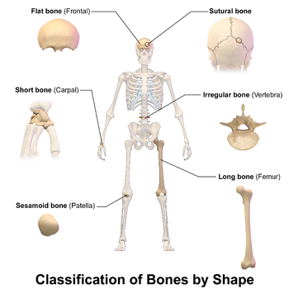
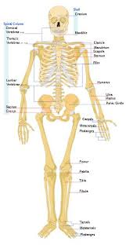
BONE NOTES
Building Bone Tissue

Slide 2
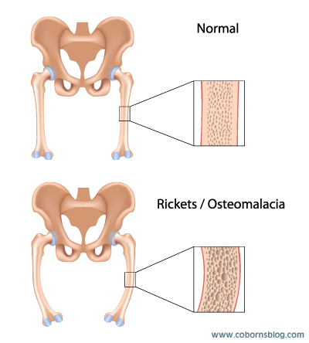
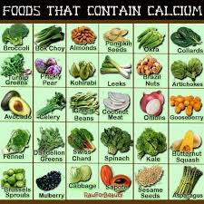
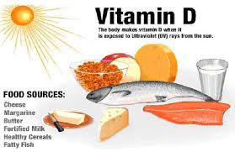
There are 3 conditions necessary for the growth and hardening of bones:
1. Adequate supply of minerals example: a. calcium b. phosphorus
2. Certain hormones(HGH) must be present for bone cells to make use of minerals.
3. Vitamins are essential for growth and remodeling of bones

Slide 3
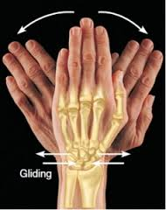
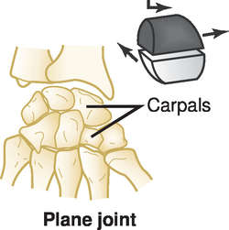
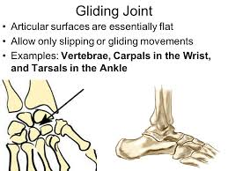
Joints of the Body
1. Gliding: allow the bones to glide past one another in any direction along the plane of the joint– up and down, left and right, and diagonally.

Slide 4
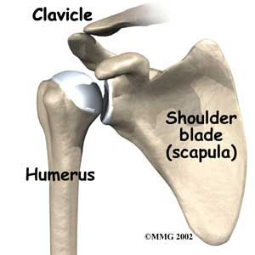
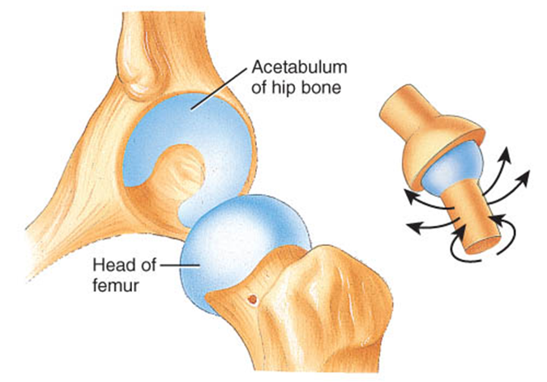
JOINTS:
2. Ball and Socket: a type of synovial joint in which the ball-shaped surface of one rounded bone fits into the cup-like depression of another bone.

Slide 5
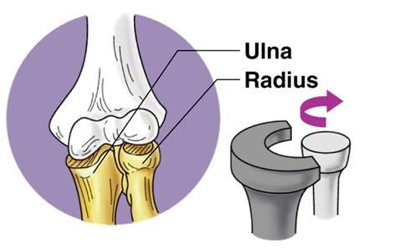
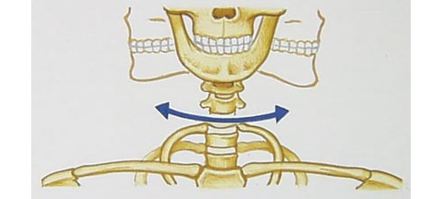
JOINTS:
3. Pivot: allow for rotation

Slide 6
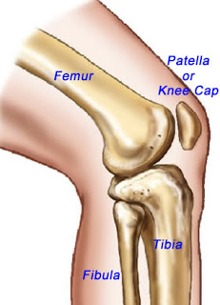
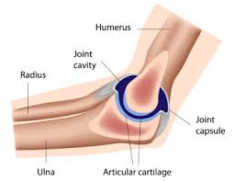
JOINTS:
4. Hinge: formed between two or more bones where the bones can only move along one axis to flex or extend.

Slide 7
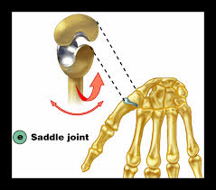
JOINTS:
5. Saddle: where one of the bones forming the joint is shaped like a saddle with the other bone resting on it like a rider on a horse.

Slide 8
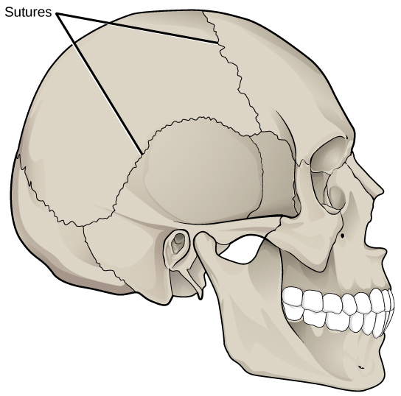
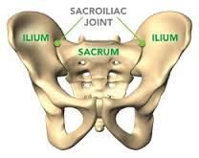
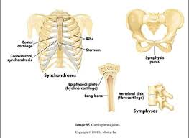
JOINTS:
Immovable: where two bones are joined together where little or no movement normally happens.

Slide 9
JOINTS:
7. Partially/Slightly Movable: limited movement

Slide 10
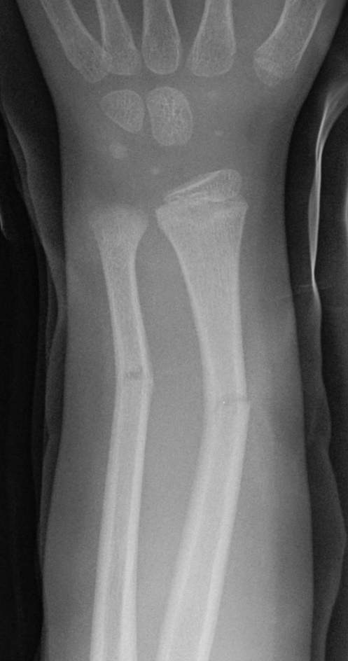
BONE FRACTURES:
1. Greenstick:a fracture of the bone, occurring typically in children, in which one side of the bone is broken and the other only bent.

Slide 11
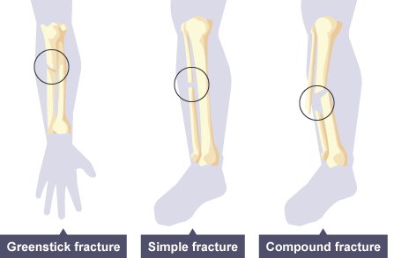
Simple Fracture:
a fracture of the bone only, without damage to the surrounding tissues or breaking of the skin.

Slide 12
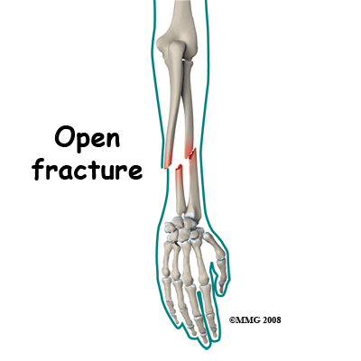
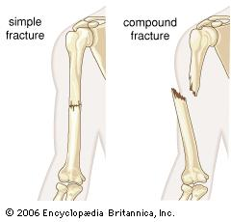
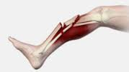
Compound Fracture:
A fracture in which a bone is sticking through the skin. Also known as an open 'fracture

Slide 13
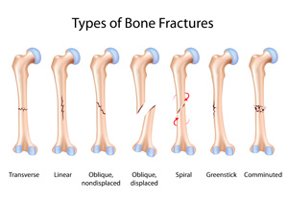
TYPES OF FRACTURES
ALL:

