Slide 1
Chapter 1A
The Quality of Our Water

Slide 2
1A.1 Measurement and the Metric System
Measurement
When we perform experiments, we need to use some form of measurement.
Measurements contain numbers and UNITS

Slide 3
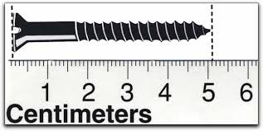
All measurements involve some estimation
Which ruler requires the most estimating?

Slide 4
Now lets try it…Measuring techniques WS in your packet

Slide 5
Guessing and measuring
All measurements MUST have a number at the end (ONLY ONE) that is your guess between the lines!
what we know guess between the lines
2.2 cm

Slide 6
Back to the WS…

Slide 7
Metric Base Units
Mass = gram (g)
Length = meter (m)
Volume = (L)
Time = seconds (s)
Count, quantity = mole (mol)

Slide 8
Prefixes
…can make the base unit smaller or LARGER
Smaller | LARGER
Deci (d) 1/10th smaller | Kilo (k) 1000 x LARGER
Centi (c) 1/100th smaller | Hecto (h) 100 x LARGER
Milli (m) 1/1000th smaller | Deca (dk) 10 x LARGER

Slide 9
Worksheet: The Metric System

Slide 10
Metric conversions - To convert from one unit to another set up a proportional relationship between two equations.
₌
Start with set up above
Add units from the problem so that the top units on each side match and the bottom units on each side match.
Look at the two units and decide which the larger unit. Put a 1 in front of that unit on the left side of the set up. Use the cheat sheet to put a 10, 100, or 100 in front of the smaller unit on the left side.
Use the problem to fill in the right side.
Cross multiply and solve for X

Slide 11
Example
Convert 15 m to cm
15 m = X cm AND 1 m = 100 cm
15 m = 1 m
X cm 100 cm
(X)(1) = (15)(100)
X = 1500 cm

Slide 12
Now you try it…
Metric Conversion Worksheet (in your packet)

Slide 13
Now converting with a twist
Convert 123 cg to mg…so what’s the twist???
Both measurements have prefixes … there are TWO prefixes … so you need to do TWO proportions
First proportions to get to the BASE unit, the second to get to the GOAL unit!

Slide 14
Convert 123 cg to mg
First conversion…
123 cg = 100 cg
X g 1 g
(100)(X) = (123)(1) X = 1.23 g
100 100
Second conversion…
1.23 g = 1 g
X mg 1000 mg
(1.23)(1000) = (X)(1) X = 1230 mg

Slide 15
A.4 Water and Health
Living things require a continual supply of water
Humans must drink at least 2 liters (2 quarts) per day
You can only live 5-10 days without water
Throughout history clean water has been a necessity
As populations increase clean water becomes everyone’s concern

Slide 16
A.5 Water Uses
Each day 15 trillion (15,000,000,000,000,000) liters of water fall on the US
10% is used by humans and the rest flows, evaporates and falls again
The perpetual falling, flowing, evaporating, and falling (again) of water is called the water cycle or the hydrologic cycle.
Water usage in the United States varies by region
The average family of four uses about 1360 liters daily. This is about 360 gallons daily. This is considered direct usage.
There are many more indirect uses of water.
http://www.waterfootprint.org/?page=cal/WaterFootprintCalculator

Slide 17
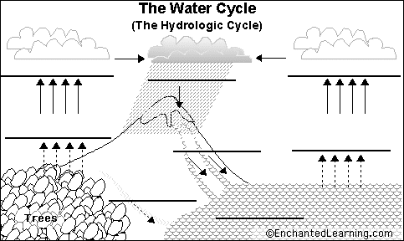
http://www.youtube.com/watch?v=yfLTBJKnEQA&feature=related

Slide 18
A.6 Back Through the Water Pipes
There are two sources of water for consumption: surface water and ground water
Ground water collects in aquifers.

Slide 19
A.7 Where is the Earth’s Water?
It exists in the solid state (ice and snow), the liquid state (rivers, streams, groundwater) and the gaseous state (water vapor in the clouds and atmosphere)
97 % is in the oceans
2.11 % is in glaciers and ice caps
0.62 % is in groundwater
0.009 % is in lakes,
0.001 % is in the atmosphere
0.0001 % is in rivers, streams, ponds, etc.

