Slide 1
Using Your PSAT/NMSQT® Scores to Increase College Readiness
A Lesson Plan to Use With Students
2019

Slide 2
Naviance Required Task at the end of lesson. 1. Name at least one thing you learned from today’s presentation. 2. What will you do to improve your future PSAT/SAT/ACT scores – there multiple choice responses.

Slide 3
What Are the Benefits of Taking the PSAT/NMSQT®?
Prepare for the SAT®
Get free, personalized Official SAT Practice on Khan Academy®
Start getting ready for college with college and career planning tools
Enter the National Merit® Scholarship Program
See which AP® courses for which you might be ready
Get admission and financial aid information from colleges
Notes:
Ask students if they are planning to take the SAT. Inform them that the SAT is aligned to the PSAT/NMSQT. The PSAT/NMSQT is a preview of the content on the SAT and will help them practice for the SAT. PSAT/NMSQT scores, and all scores in the SAT Suite of Assessments, are accessible from the student’s online College Board account.
The PSAT/NMSQT offers several benefits:
When students link their College Board account with their Khan Academy® account, Khan Academy will use the PSAT/NMSQT scores to design a practice plan and practice questions tailored to each student’s strengths and areas for improvement. This program is completely free, and practice test questions on Khan Academy are created with College Board approval, so this is the best SAT practice available.
The student’s online score report links to valuable tools for college and career planning. Students can use BigFuture™ and Roadmap To Careers to investigate their academic interests and college and career options (more about BigFuture and Roadmap To Careers at the end of this lesson, slides 33-34).
When students take the PSAT/NMSQT® , they’re automatically screened for the National Merit® Scholarship Program, an academic competition for recognition and scholarships. For more information, visit NMSC’s website or see the Official Student Guide to the PSAT/NMSQT or the Guide to the National Merit® Scholarship Program (for educators). The National Merit Scholarship Corporation (NMSC) is a co-sponsor of the PSAT/NMSQT. In addition, The College Board is partnering with several other organizations who provide millions of dollars in scholarships to qualified low-income and minority students. Students who opt in to Student Search Service can be identified by these organizations.
PSAT/NMSQT scores are indicators of ability to succeed in Advanced Placement® courses. Students can find the AP® courses in which they are likely to succeed in the online reporting system (more information about the online reporting portal begins on slide 8).
If students opt in to Student Search Service® , they will receive information about admission and financial aid from colleges that participate in the program. (More information on Student Search Service is available on slide 34.)

Slide 4
How Do I Access My PSAT/NMSQT® Scores and Reports?
Review your online reports.
Review your paper score report.
Notes:
Students have two options for accessing their PSAT/NMSQT scores:
Through their College Board account
Viewing their paper score report
The best method for students to get information about all of their scores and other college planning resources is to log in to their College Board account.

Slide 5
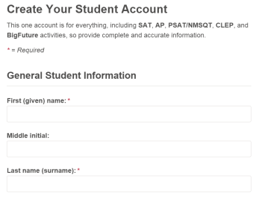
How Do I Access My Online PSAT/NMSQT® Scores and Reports?
Log in to an existing College Board account or create a new one at studentscores.collegeboard.org.
Notes:
If this lesson takes place in a computer lab setting or where students have internet access, ask them to log in to their College Board accounts (or to sign up for an account using the instructions below), and follow along with the screen shots in the PowerPoint presentation. Use this slide to guide students through the sign-up process, or to provide information about signing up at a later time.
Go to studentscores.collegeboard.org.
Click “Sign Up” under the Sign In spaces.
Input your personal information under “Create Your Student Account.” Remind students that this information (name, date of birth, email address) must match the information students provided in the student questionnaire on the PSAT/NMSQT.

Slide 6
Setting up account for Sophomores 1. Go to studentscores.collegeboard.org 2. Click “sign up” under the Sign In spaces. 3. Input your personal information under “Create Your Student Account” Juniors – DO NOT set up a new account if you made one last year.

Slide 7
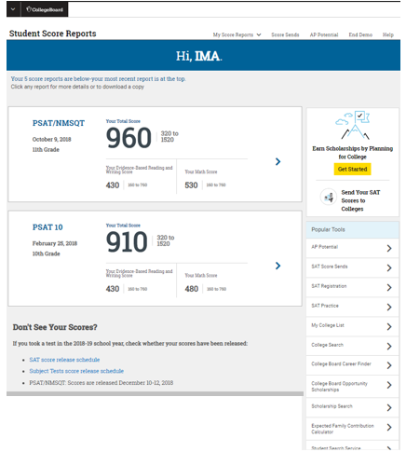
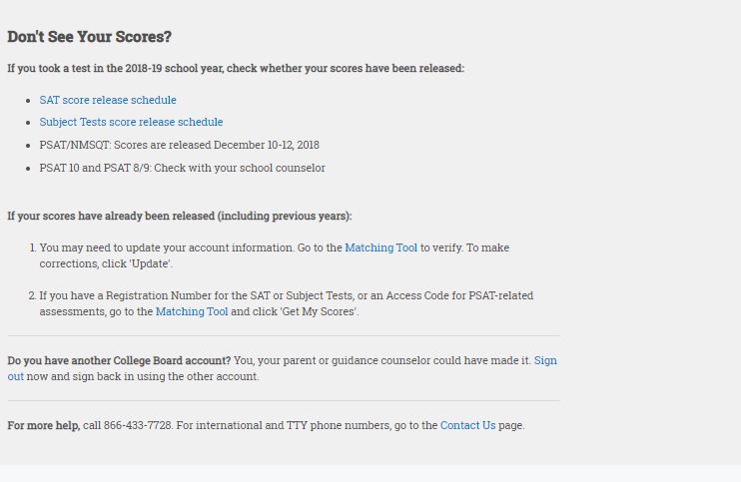
How Do I Access My Online PSAT/NMSQT® Scores and Reports? (cont.)
Log in to your account.
Select PSAT/NMSQT Scores.
*OR*
Use the “Matching Tool” to locate scores.
Notes:
Once students have set up their College Board account, they will need to log in to the account to access score information. Students should enter their username and password (at studentscores.collegeboard.org). They will be redirected to their SAT Suite of Assessments score reporting portal, with their most recent test showing first.
If their most recent test is missing, they can go to the bottom of the screen for suggestions to find their scores under “Don’t See Your Scores?”. When they click “Matching Tool” they will verify and update their information and click Get My Scores.
Students’ email addresses must match their registration information for scores to be loaded in the account. Students can call College Board Customer Service if they are having difficulty seeing their scores (Phone: 866-433-7728 or Email: psathelp@info.collegeboard.org)

Slide 8
What Will I Learn About My Scores?
Notes:
When students log in to their College Board account, they will be taken to a dashboard (entry) screen that includes their scores, links to Popular Tools like Student Search, AP Potential, and SAT Registration.
The first thing they will see on the dashboard is their most recent scores. The total score for PSAT/NMSQT ranges from 320 to 1520. It is the sum of their Math section score added to their Evidence-Based Reading and Writing section score. In the example on the slide, Ima’s Total score is 960, with a 430 in Evidence-Based Reading and Writing and a 530 in Math. When students click the arrow next to their score, they will be taken to their detailed score reports.

Slide 9
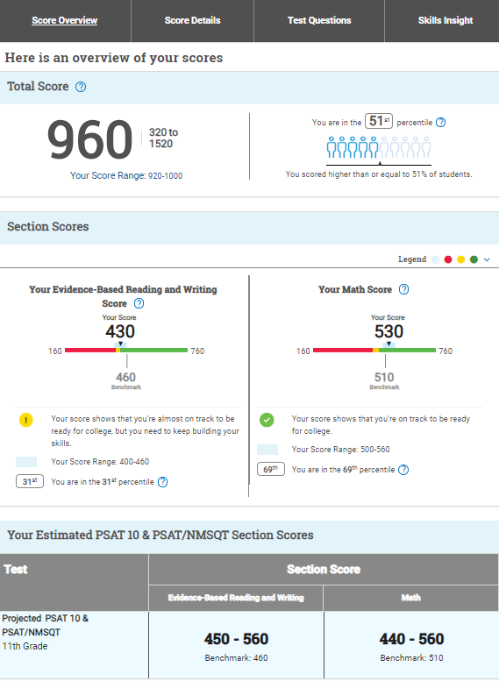
How Do I See My Detailed Scores?
Notes:
At the top of the screen, students see their Total Score. The total score for PSAT/NMSQT ranges from 320 to 1520. It is the sum of their Math section score added to their Evidence-Based Reading and Writing section score. In the example on the slide, Ima’s Total score is 960, with a 430 in Evidence-Based Reading and Writing and a 530 in Math.
Below the Total Score, students will find their section scores. “Your Evidence-Based Reading and Writing Score” is on the left (430 on the slide), and is the scaled score they earned from the Reading Test and the Writing and Language Test combined. “Your Math Score,” to the right of the total score (530 on the slide), is the scaled score they earned from taking the Math Test. Both of these section scores are on a scale of 160 to 760 on PSAT/NMSQT, and are added together to get the total score. On the SAT, the range for these section scores is 200–800.
For each score, students can see the range of minimum and maximum scores for each of these scores. Under their score, students can click to see their score range. When students take tests more than once, their scores may differ on each testing occasion. PSAT/NMSQT scores should be interpreted as ranges rather than singular points, because a student’s score might vary slightly if he or she had taken different versions of the test under identical conditions. This link will tell students their score range, based on their current score.
With each of the three scores, students are presented with their Nationally Representative Sample Percentile. This number is the percentile rank (the percentage of scores that fall below this score) for a student if ALL U.S. students, in their same grade, took the test. (It is a norm-referenced group of all U.S. students in their grade, regardless of whether they typically take the PSAT/NMSQT, derived via a weighted research study sample.) From the example on the slide, a score of 960 means this student performed better than 51 percent of students nationally. The Evidence-Based Reading and Writing score is in the 31st percentile, and the Math is in the 69th percentile. Help students find and understand their Nationally Representative Sample Percentile for the total score and for both section scores. Students can also see their User Percentile — National by clicking the circled question mark. The User Percentile — National is the percentile ranking if typical U.S. test-takers took the test at the same grade level.
Percentiles and benchmarks are provided for 10th and 11th grades on the PSAT/NMSQT. If a student is a grade-level ahead or behind, then he or she is compared to the nearest grade level. For example, a ninth-grader will be compared to 10th-grade benchmarks.

Slide 10
How Will I Do on the SAT Next Year?
The predicted SAT® score is an initial projection based on current data and concordance.
Notes:
Students receive a predicted score range for the next assessment year. Tenth-grade students receive a prediction for PSAT/NMSQT as an eleventh-grader (as seen on the slide); eleventh-grade students receive a prediction for SAT. The predicted score is an initial projection based on current PSAT/NMSQT data and concordance. The projection range may include a lower score than the student earned on the PSAT/NMSQT. The projection is based on the growth of students who scored between the 10th and 90th percentiles. Students can use the predicted information as motivation to continue to practice and prepare for the SAT.
In the example on the slide, the student has earned a 430 on the Evidence-Based Reading and Writing. This indicates the student is almost on track to meet grade-level benchmark. The projected score is between 450 and 560. Ask students to consider whether their projected scores meet their goals and meet or exceed the grade-level benchmark. As you review the practice and planning resources in the next slides, ask students to commit to a plan for practice in preparation for taking future assessments.

Slide 11
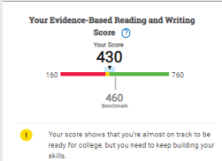
How Did My Score Measure Against the Benchmarks?
Section scores
Need to Strengthen Skills = below grade-level benchmark by more than one year
Approaching Benchmark = below grade-level benchmark by one year or less
Meets or Exceeds Benchmark = at or above grade-level benchmark
Test scores and subscores
Red, yellow, and green ranges reflect areas of strengths and weaknesses compared to the typical performance of students.
Section, test, and subscores all report scores in performance zones that indicate whether you are on track for meeting the college readiness benchmarks on the SAT®.
Notes:
Students will see their numerical score for each section, test, and subscore. The section score graphic shows where the student score falls on a continuum, and is colored to demonstrate how the score corresponds to the grade-level benchmark. There is a grade-level benchmark for Evidence-Based Reading and Writing, and a grade-level benchmark for Math. Students who meet the grade-level benchmark are on track for meeting the corresponding college readiness benchmark on the SAT. For their section scores, if the score falls in the red area of the graphic, they “need to strengthen their skills,” meaning they are more than one year below the grade-level benchmark. If the score falls in the yellow part of the graphic, they are “approaching benchmark,” or below the grade-level benchmark by one year or less. If the score falls in the green area of the graphic, they are on track to meet the college readiness benchmark and have met or exceeded the grade-level benchmark.
For the test scores and subscores, which are also shown on a color-coded continuum, the colors in the graphics represent relative strengths (green) and weaknesses (red) based on typical student performance. The color coding doesn’t reflect how students performed compared to the benchmark, as it does with Section scores.

Slide 12
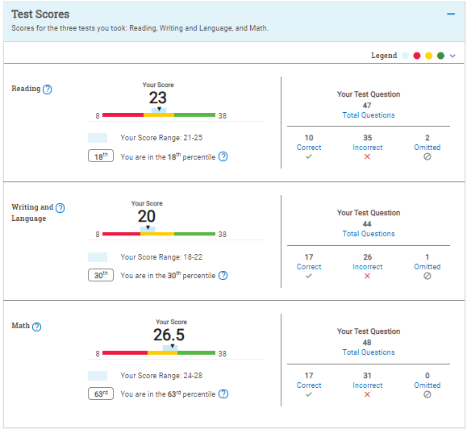
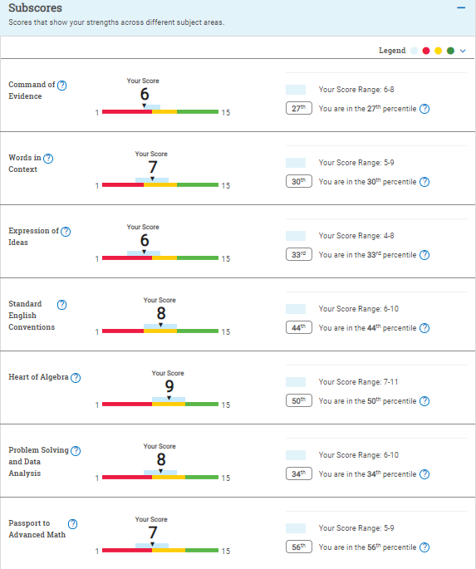
What Do My Scores Tell Me?
Test scores, cross-test scores, and subscores give students insightful information about their strengths and areas for improvement.
Notes:
Students receive in-depth information about their performance on the PSAT/NMQT. Test scores, cross-test scores, and subscores are intended to give students insightful information about their strengths and areas for improvement.
Test scores on PSAT/NMSQT range from 8 to 38. By reviewing their test scores, students can discover if they performed better on the Reading Test or the Writing and Language Test, which together produce the Evidence-Based Reading and Writing section score. For example, in the sample on the slide, this student scored a 23 and is in the yellow on the Reading Test, indicating he is below the average student performance of those who met the benchmark by one year or less in Reading. He earned a 20 on the Writing and Language Test and is in the green (meet or exceeds the average student performance of those who met the benchmark). In Math, he earned a 26.5. His score is in the red area, indicating he needs more than one year’s growth to meet the average score of students who met the grade-level benchmark.
The range for subscores is 1–15. Three subscores are generated from the Math section (Heart of Algebra, Problem Solving and Data Analysis, and Passport to Advanced Math); four subscores are generated from the Evidence-Based Reading and Writing Section. Of those four subscores, two are generated from the Writing and Language Test only: Expression of Ideas and Standard English Conventions. Command of Evidence and Words in Context are derived from questions on both the Reading Test and the Writing and Language Test. In the sample on the slide, this student earned a 7and is in the yellow on Words in Context, but earned a 9 and is in the green on Command of Evidence, demonstrating relative areas of strength and weakness, and clarifying the areas in which he or she can work to improve.
Cross-test scores are derived from questions related to science or history/social studies on the Reading Test, the Writing and Language Test, and the Math Test. The range for cross-test scores is between 8 and 38 on PSAT/NMSQT.

Slide 13
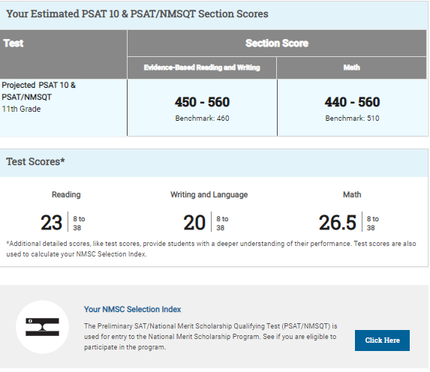
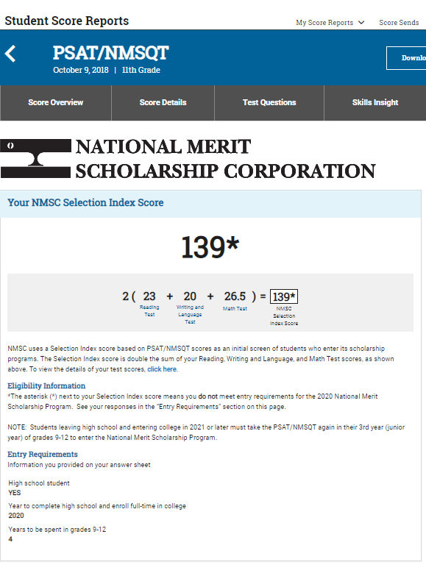
What Is the National Merit® Scholarship Program?
Notes:
The National Merit Scholarship Program is an academic competition for recognition and scholarships that began in 1955. Of the 1.5 million students who take the PSAT/NMSQT, some 50,000 with the highest PSAT/NMSQT Selection Index scores qualify for recognition in the National Merit Scholarship Program. In September, these high scorers are notified through their schools that they have qualified as either a Commended Student or a Semifinalist.
Students can find their NMSC Selection Index by clicking Click Here at the bottom of the PSAT/NMSQT overview of their scores.
Selection Index scores are calculated by doubling the sum of the Reading, the Writing and Language, and the Math Test scores. Students can find this score in the middle of the top of page 3 of the paper score report. If there is an asterisk after the number, the student is not eligible for the competition during this test administration.
For more information, visit NMSC’s website or see the Official Student Guide to the PSAT/NMSQT or the Guide to the National Merit® Scholarship Program (for educators).

Slide 14
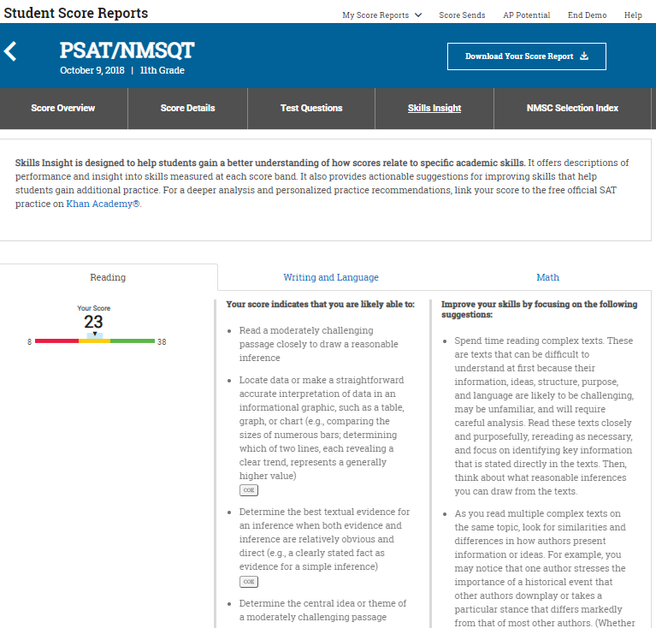
How Can I Improve My Academic Skills?
Skills InsightTM informs you about what you are already likely able to do, and how you can improve your skills.
Notes:
Skills Insight™ is a tab on the top of the Score Report screen. Skills Insight gives students more information about the knowledge and skills they have demonstrated, and the knowledge and skills on which they should focus for growth. Skills Insight connects a student’s focus areas to the subscores and the skills that are assessed. Students can click on the Questions box to see the questions associated with the skills and subscores.
There is a link on the top of the page connecting students to Khan Academy, which will use their scores (if students link their College Board and Khan Academy accounts) to develop a free online personalized practice program. If this presentation takes place in a computer lab, have students go to Khan Academy, link their College Board account, and look at their practice program (see slides 26-29).
Ask students to write down the areas in which they can improve their skills (from the right side of the screen), and then think about and commit to ways to work on those skills. Their plans might include practicing on Khan Academy or using a study period to work with a teacher. Plans may include assignments that teachers provide in their classes. It is helpful for students to develop plans for skill development as they review their scores.

Slide 15
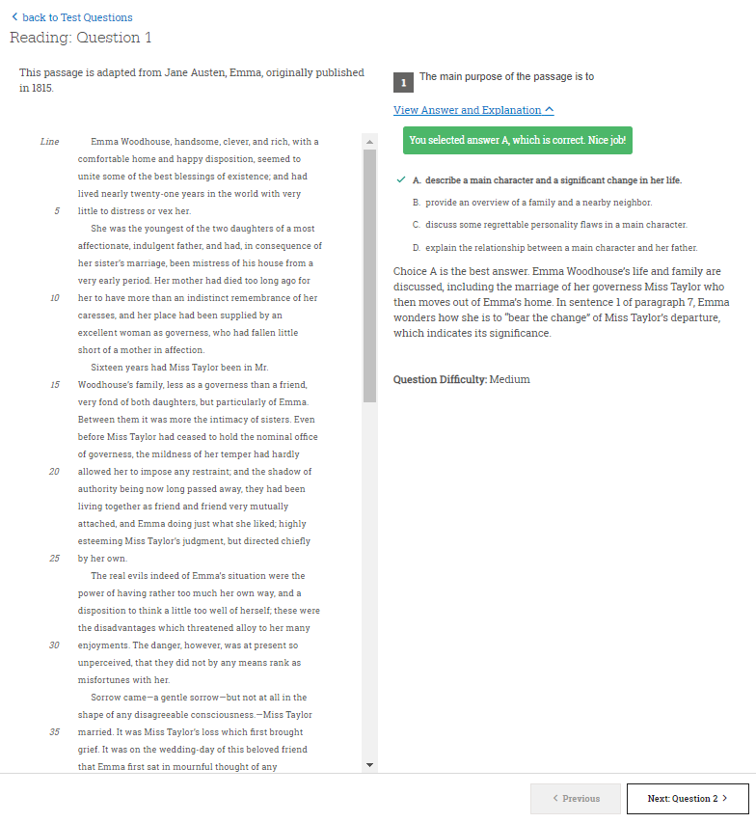
What Can I Learn from My Answers?
See the actual questions, answer choices, and the answer selected.
Look at the online score report and consider the following:
Which questions were answered incorrectly?
What is the correct answer and the answer explanation?
Why was the error made?
Which answer explanations need additional explanation from your teacher?
Notes:
Students can look at the test questions from the PSAT/NMSQT using the Test Questions tab on the Score Report screen, or by clicking the Questions button on the Test Scores screen.
For most PSAT/NMSQT administrations, students can see the question content and answer explanation with their scores, which can help them understand why they got a question right or wrong. Students can review the question content if the question numbers are hyperlinked on the Test Questions page.
Students will benefit from reviewing the questions they missed on the PSAT/NMSQT, understanding the correct answer, and thinking about why they selected the incorrect answer. Ask students to select questions they answered incorrectly, read the questions and the answers, and determine what mistakes they made that led them to choose the incorrect answers. Recognizing and correcting their mistakes may help them avoid the errors in the future.

Slide 16
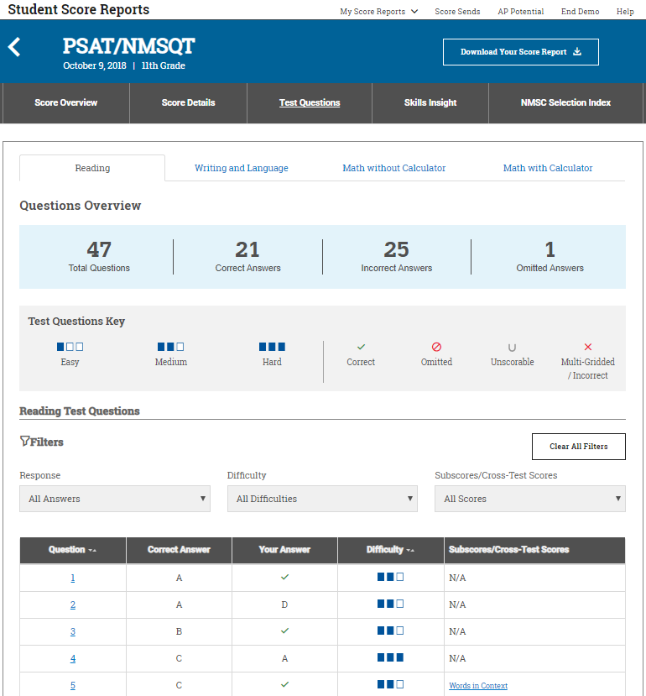
What Can I Learn from My Answers? (cont.)
Check the level of difficulty of each question and the related subscores and cross-test scores.
Look at the types of questions answered incorrectly and skipped and consider the following:
Identify the level of difficulty. How many questions did I miss at each level?
Was I more likely to skip questions associated with any subscore or cross-test score?
What inferences can I make about areas for improvement based on the types of questions I missed and skipped?
Notes:
Ask students to identify the questions they answered incorrectly and determine whether they missed more questions at a higher level of difficulty. If they are missing the more difficult questions, they may need to practice with more challenging course work.
Students can also look at the questions they skipped: Were they more difficult questions, or questions associated with a particular subscore or cross-test score? Work with students to identify patterns among missed and skipped questions.
Reminder: The PSAT/NMSQT (and SAT) no longer penalizes students for incorrect answers, so encourage students to give their best answers to all questions when they take the SAT.

Slide 17
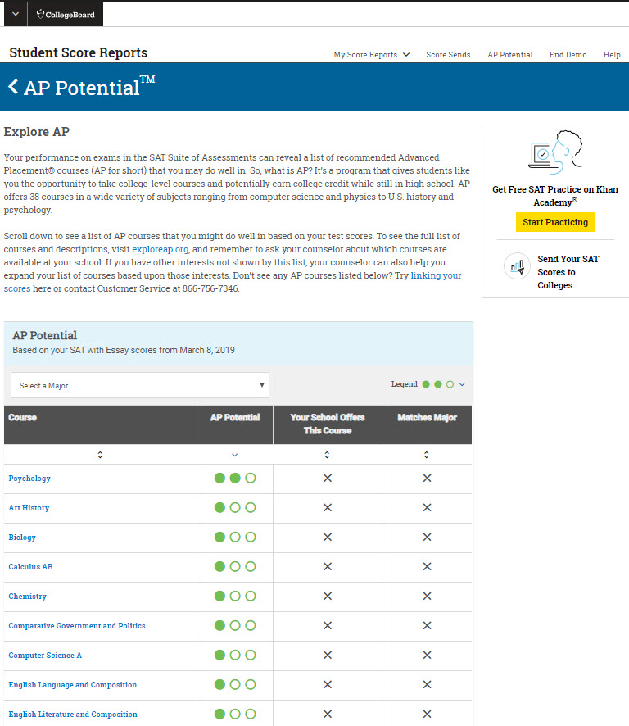
What Is AP Potential™?
AP Potential uses scores from the PSAT/NMSQT® to provide predictions for 21 AP® Exams.
College Board research shows that students who score a 3 or higher on an AP Exam typically experience greater academic success in college and are more likely to earn a college degree on time than non-AP students.
Notes:
AP Potential™ provides information about the Advanced Placement courses in which students are likely to be successful based on their PSAT/NMSQT scores. Students can access AP Potential information from the dashboard (entry) screen (see slide 10). Students will see one, two, or three dots indicating their likelihood of success on an AP Exam based on their scores. One dot means that potential is not yet demonstrated. Two dots mean there is some likelihood of success, and three dots indicate there is a likelihood of success on the AP Exam for a particular AP course.
This information should not be used in isolation to determine whether a student should or should not take AP. Students should use this as one piece of information to help them decide whether to take AP classes. They should consult with their teachers and counselors, review their course schedules, and consider their grades, interests, future plans, and work habits when deciding whether to take an AP class.
Students can also see which AP courses have previously been offered at their school, and which AP courses align to college majors in which they are interested.

Slide 18
What Are My Next Steps?
Continue to take challenging courses in high school
Link scores with Khan Academy®
Set up a practice plan and stick to it
Register for the SAT®
Utilize other resources to research and prepare for college
2019
Notes:
Upcoming slides will explain Official SAT Practice with Khan Academy, SAT Registration, BigFuture, Roadmap to Careers, and Student Search Service.

Slide 19
Official SAT® Practice with Khan Academy®— It’s FREE!
Go to satpractice.org and create a free account.
Get personalized recommendations. Link your Khan Academy account to your College Board account to import past SAT Suite results or take diagnostic quizzes to get personalized recommendations.
Create a study plan. Select a test date and set up a practice schedule.
Notes:
Official SAT Practice on Khan Academy is offered to students at no cost. Students have access to thousands of official SAT test questions (written and reviewed by the College Board) and six full-length SAT tests. Students can access Official SAT Practice on a computer, or by using the Daily SAT Practice app or Khan Academy app on their mobile device. Khan Academy creates personalized learning plans for each student based on his or her test performance and practice on Khan Academy. It also provides videos that will tutor students in the areas in which they need help.

Slide 20
How Can I Practice with Khan Academy®?
Watch a video introducing
Official SAT Practice on Khan Academy
Thousands of practice questions and videos covering every SAT® concept
Eight official, full-length SAT practice tests with more to come
Personalized recommendations based on each student’s strengths and weaknesses
Tailored practice schedule mapping out each students’ path to test day
SAT tips and strategies, sharing information about each part of the test
Notes:
This slide links to a video that demonstrates the features of Official SAT Practice on Khan Academy. Students in a computer lab setting can set up their accounts immediately. They have to enter their name, email address, and birth date, and will immediately receive a link to set up a username and password. They can also use their Gmail or Facebook login information to get started immediately. They can then log in to the account and begin practicing.

Slide 21
What Steps Will I Follow to Link My College Board Account to Khan Academy®?
Step 1
Log in or create a Khan Academy account.
Step 2
When prompted, agree to link your Khan Academy and College Board accounts. You will then be directed to collegeboard.org.
Step 3
Sign in or create a College Board account.
Step 4
When prompted, hit “Send” to authorize the account linking.
Step 5
Start practicing on Official SAT® Practice on Khan Academy!
Notes:
In order to receive personalized practice plans based on their PSAT/NMSQT results, students will have to link their Khan Academy accounts and their College Board accounts. To begin the linking process, students must log in to their Khan Academy accounts. Students will be prompted to link their Khan Academy and College Board accounts when they log in. When students agree to link the accounts, they will be directed to collegeboard.org. When they reach collegeboard.org, they will need to sign in to their College Board account.

Slide 22
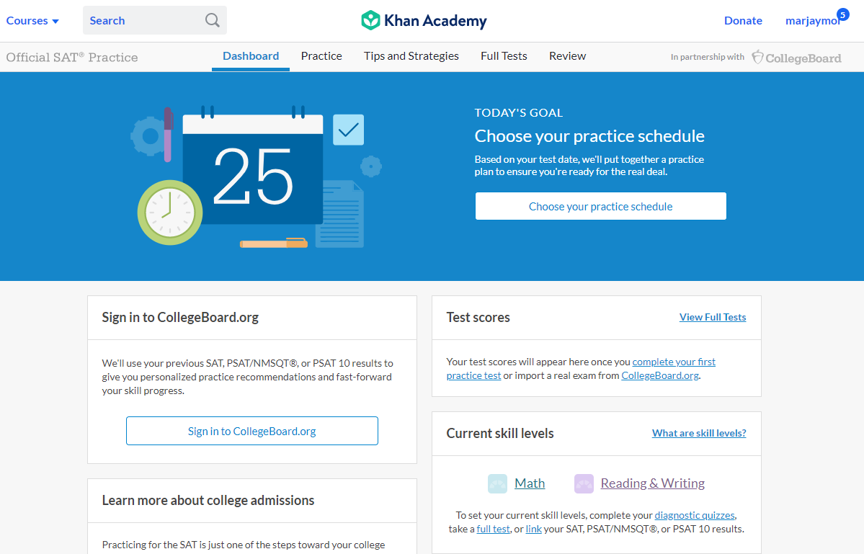
How Can I Link My College Board and Khan Academy® Accounts?
After successfully logging in to your College Board account, you will be asked to authorize the account linking.
After clicking “Send,” you will be redirected to SAT® Practice on the Khan Academy site.
You can remove the link at any time by clicking on “Revoke,” which is found in your College Board account settings.
Notes:
After successfully logging in to the College Board account, they will be asked to authorize the linking of the accounts. This allows Khan Academy to access student score data related to the SAT Suite of Assessments. Students will see a screen clarifying what they are agreeing to link. If they choose to click “Send,” they will be directed back to Official SAT Practice on Khan Academy. Students can choose to remove the link by clicking on “Revoke” in the College Board account settings.

Slide 23
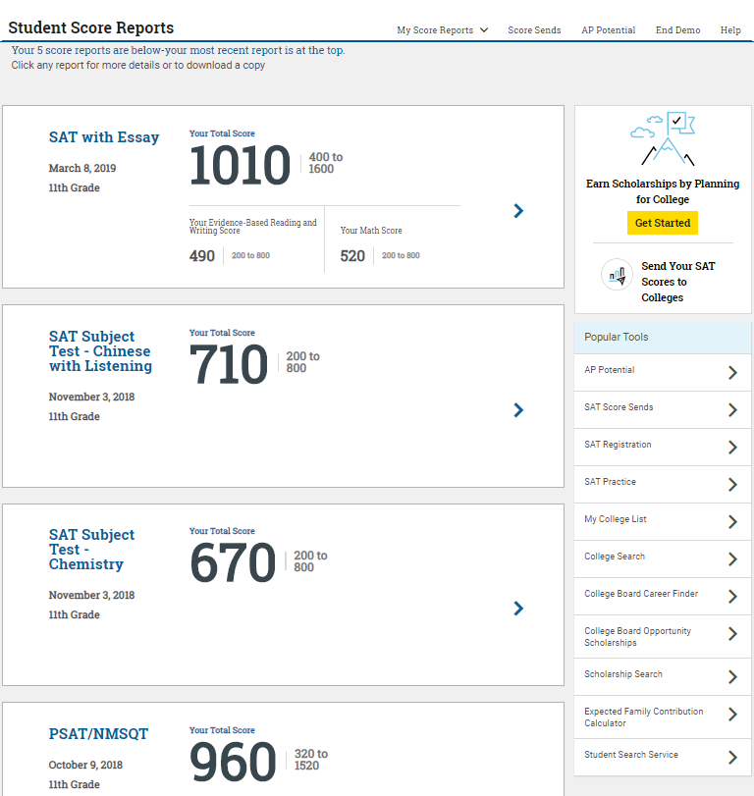
How Do I Register for the SAT®?
SAT Registration link from Popular Tools menu
sat.org/register
Notes:
Students who took the PSAT/NMSQT have seen a test that is similar in content and format with the SAT. They have already started practicing for the SAT by taking the PSAT/NMSQT!
Students can navigate to the SAT registration site by clicking on the Popular Tools menu within the online score report and selecting SAT Registration. This will open a new window for sat.org/register. They will need photos of themselves to upload for verification. The complete registration checklist is available at https://collegereadiness.collegeboard.org/sat/register/online-registration-help.
Fee waivers are available for students who demonstrate financial need. Direct students to their counselors to get further information about fee waivers.

Slide 24
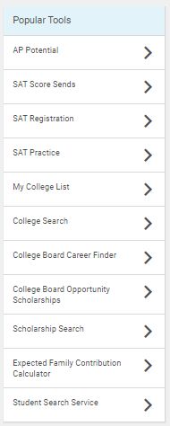
What Additional Resources Will Help Me Prepare for My Future?
BigFuture™
College Action Plan
College Search
Scholarships
Financial Aid
Career Finder
Student Search Service®
Notes:
Students have multiple resources available to help them plan and prepare for college. The Popular Tools menu includes links to other College Board tools within BigFuture and CareerFinder™ .
The College Board developed BigFuture in collaboration with parents, students, and educators to make the college planning process easier and less overwhelming. At bigfuture.org, students can:
› Use intelligent search-and-match tools and informative videos to find colleges that are a good fit.
› Learn how families have paid for college.
› Create a personalized plan for college so students know what to do and when to do it.
Career Finder provides a career exploration tool that can help students learn more about their interests and how this may correspond to a future career.
Student Search Service connects colleges with potential students.

Slide 25
COLLEGE BOARD OPPORTUNITY SCHOLARSHIP https://youtu.be/2CPku32bj5I

Slide 26
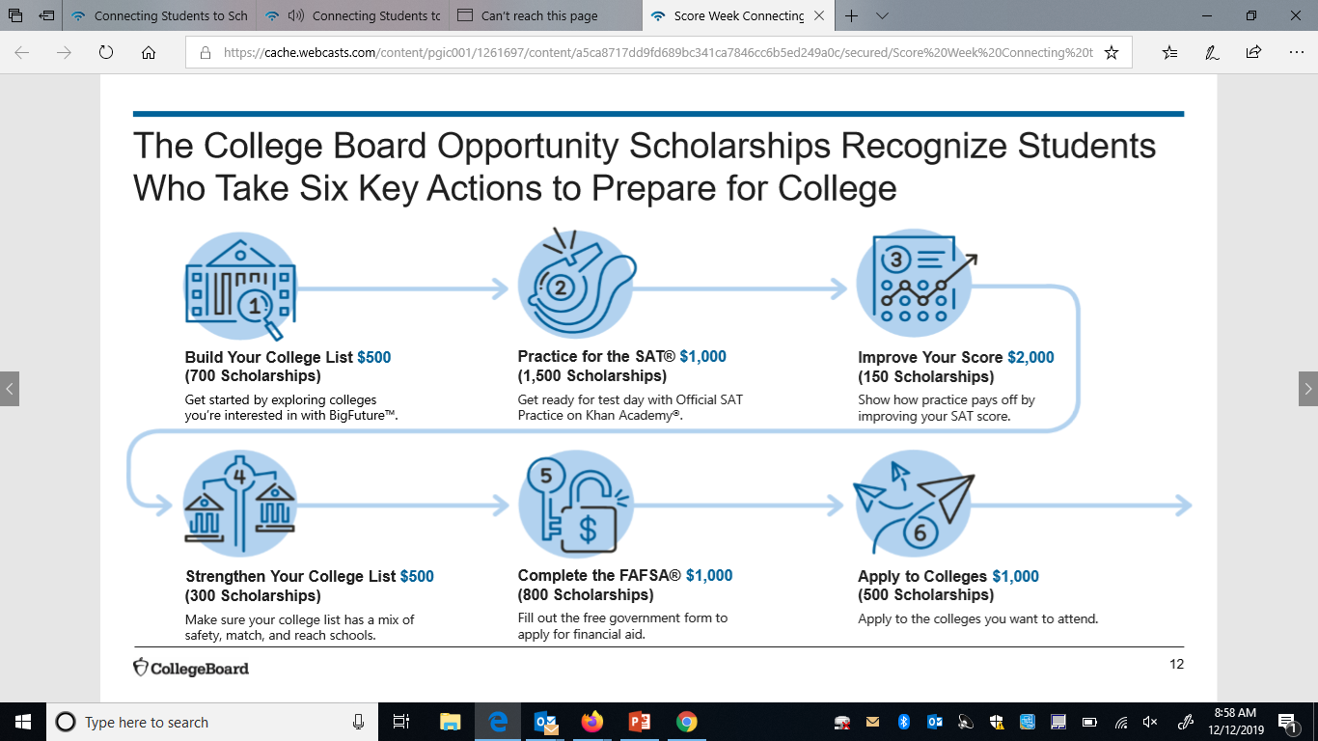
Opportunity Scholarship

Slide 27
Opportunity Scholarship Continued You must opt in to be a participant.

Slide 28
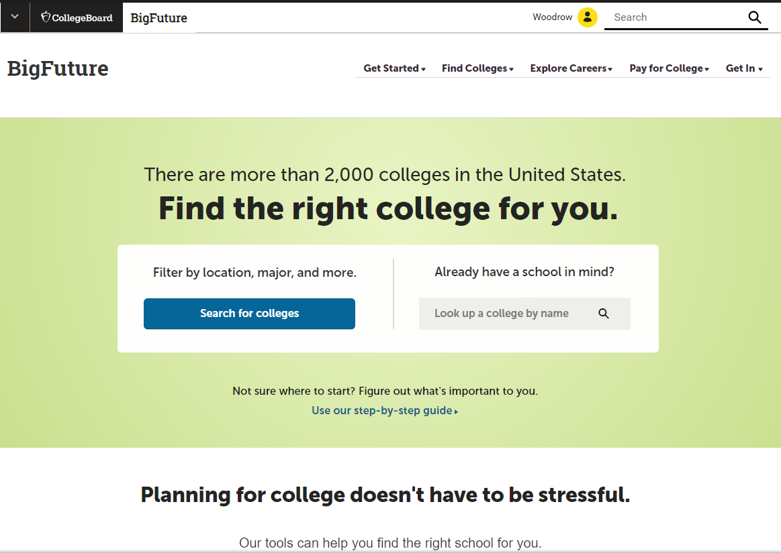
BigFuture™— Search Colleges, Scholarships, and Careers
Search for colleges.
Watch videos from real students.
Hear from education professionals.
Learn about different colleges.
Get help paying for college.
Build a personalized plan for getting into college.
Notes:
BigFuture is the website that helps students plan for college. It is a free, comprehensive website that guides students as they prepare for, find, and enroll in college. At bigfuture.org, students can:
Start with a focus on themselves: their interests, what and where they want to study, how much financial assistance they think they’ll need, and other important considerations.
Search for colleges and easily compare them based on factors ranging from majors to size and location.
Watch videos from real students who explain what they did to get into college and what their college experiences have been like.
Hear from education professionals who provide the inside story on preparing for and getting into college.
Learn about the different kinds of colleges and how to find one that is the right fit for them.
Find valuable help in paying for college by discovering what goes into college costs and how to find financing.
Build a personalized plan for realizing their goals and getting into a college that meets their needs.

Slide 29
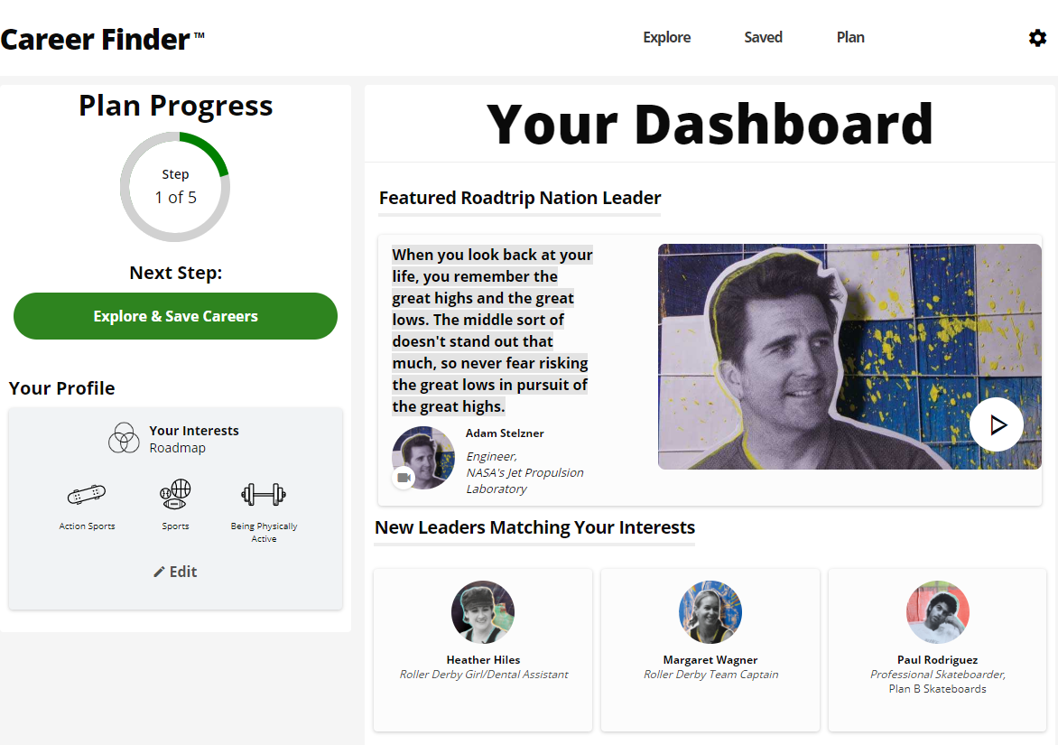
Career Finder
Roadtrip Nation and College Board have partnered to help students connect with careers.
Choose your core interests.
Watch videos of leaders who share your interests.
Learn about majors and careers that align to your interests.
See examples of leaders who followed a similar path.
Notes:
Career Finder can then blend all of those together to create a personalized journey for students through people, careers, and majors that align with their interests. It starts by looking at Leaders who match their interests. They might be famous people, or the glass blower down the street who loves her job. Students watch videos of these Leaders talking about their path, and they can see what education and path the Leaders followed. Students learn about majors that align to their interests, get tangible recommendations for ways to be ready for this major (through coursework and otherwise), and see examples of Leaders who have followed a similar path. Finally, students can learn more directly about careers that align with their interests so that they know why it’s worth putting in the effort in their high school classes and worth going to college.

Slide 30
Student Search Service®
Connects students with information about educational and financial aid opportunities.
Participate voluntarily.
Connect with more than 1,200 colleges, universities, scholarship programs, and educational organizations.
Sign up when you take an assessment in the SAT® Suite:
Choose to participate in Student Search Service when registering for a College Board test (fill in the circle on the answer sheet).
Provide information about yourself on your answer sheet.
Participating organizations can then search for groups of students who may be a good fit.
FYI: The College Board never shares information on disabilities, parental education, self-reported parental income, Social Security numbers, phone numbers, or actual test scores through Student Search Service.
Notes:
Student Search Service is a voluntary program that connects students with information about educational and financial aid opportunities from more than 1,200 colleges, universities, scholarship programs, and educational organizations. Here’s how it works:
› Students may choose to participate in Student Search Service when registering for a College Board test.
› As part of taking the PSAT/NMSQT, students are asked to provide information about themselves on their answer sheet.
› Participating, eligible organizations can then search for groups of students who may be a good fit for their communities and programs, but only among those students who opt to participate in Student Search Service.
› The search criteria can include any attribute from the answer sheet; however, information on disabilities, parental education, self-reported parental income, Social Security numbers, phone numbers, and actual test scores are not shared. The most searched items are expected high school graduation date, cumulative grade point average (GPA), and intended college major. If students have questions or concerns about Student Search Service or want more information about the program, please tell them to go to collegeboard.org/student-search-service or to call 866-825-8051.
Here are some points to keep in mind about Student Search Service:
» Colleges participating in Student Search Service never receive student scores or phone numbers. Colleges can ask for names of students within certain score ranges, but exact scores are not reported.
» Being contacted by a college doesn’t mean you have been admitted. You must submit an application in order to be considered for admission. The colleges and organizations that participate want to find students who will fit their environment, classes, programs, scholarships, and special activities. Student Search Service is simply a way for colleges to reach prospective students like you and to let them know about the opportunities that are available.
» Student Search Service will share your contact information only with colleges and qualified nonprofit educational or scholarship programs that are recruiting students like you. Your name will never be sold to a commercial marketing firm or a retailer of merchandise or services (such as test prep). Student Search Service communications are sent by outside colleges, scholarship programs, and educational opportunity organizations

Slide 31
Complete the task 1. Log into Naviance 2. MHS: 2019 PSAT/SAT Goal setting questions. 3. My planner, tasks…complete

Slide 32
College Board Opportunity Ambassador Program Stay tuned for a program that will have peers working with students regarding the Opportunity Scholarship program. Announcements will be made when ready.

Slide 33
Thank You.

